Slide 1
ANNOUNCEMENTS today is No Laptop Monday!
WARMUP "a chain is only as strong as its weakest link"
- what does this expression mean?
- what is a chain?
- what is a link?
- is this true for real-world metal chains? why or why not?
TODAY linked lists

Slide 2


Slide 3
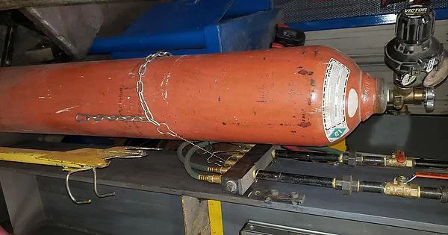

Slide 4
Kahoot review (map, %, modifying data while you iterate over it)

Slide 5
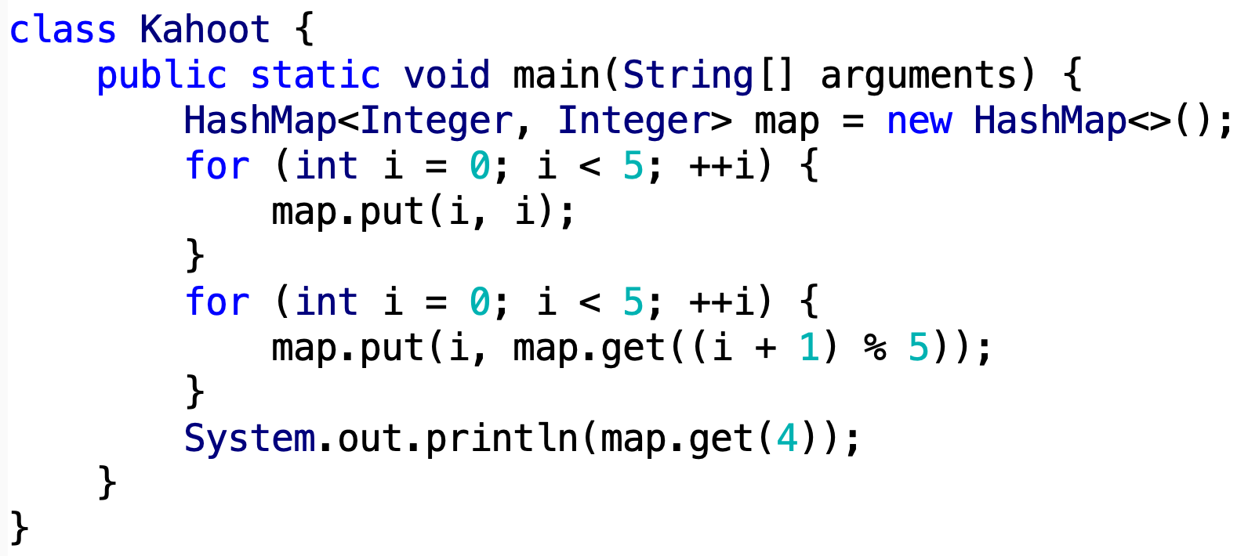

Slide 6
linked lists

Slide 7
review: list interface

Slide 8
list interface
// Get the element with this index.
ElementType get(int index);
// Add (append) an element to the back of the list. void add(); // Add (insert) an element into the list so it has this index void add(int index, ElementType element);
// Remove (delete) the element in the list at this index. void removeByIndex(int index); // Remove (delete) the first element with this value. void removeByValue(ElementType element);
// Get the number of elements currently in the list. int size();

Slide 9
list interface
// Many other functions can be included in the list interface.
void sort(); // Sort the list.
void reverse(); // Reverse the list.
List<ElementType> sorted(); // Get sorted copy of the list.
List<ElementType> reversed(); // Get reversed copy of list.
// Get index of first element with this value. int find(ElementType element);
...

Slide 10
a few weeks ago, we implemented the list interface using an array this was the array list

Slide 11
now we will implement the list interface using nodes with links to other nodes this will be the linked list

Slide 12
why are we doing this?

Slide 13
it will be cool to see two very different implementations of the same interface ☃️

Slide 14
review: array list

Slide 15
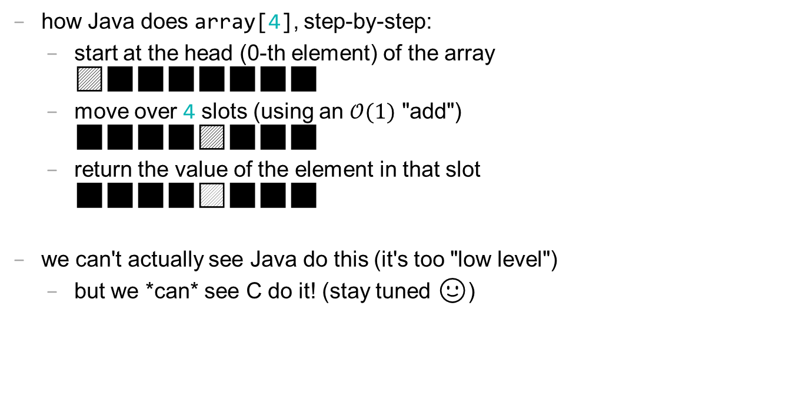
review: accessing an array [list] is O(1)
how Java does array[4], step-by-step:
start at the head (0-th element) of the array 🟦⬛⬛⬛⬛⬛⬛⬛
move over 4 slots (using an $𝒪(1)$ "add") ⬛⬛⬛⬛🟦⬛⬛⬛
return the value of the element in that slot ⬛⬛⬛⬛🟨⬛⬛⬛
we can't actually see Java do this (it's too "low level")
but we *can* see C do it! (stay tuned 🙂)

Slide 16
runtime of array list operations
get() – a single operation that retrieves a value from privateArray
O(1)
set() - a single operation that sets a value in privateArray
O(1)
add() – insert element, shift other elements down to make room in for loop
O(1) – if adding to back (and no need to make room)
O(n) – if adding to middle
O(n) – if adding to any location and we have to grow privateArray (ideally this won’t happen often)
remove() – remove element, shift other elements down to eliminate gap
O(n)

Slide 17
linked list

Slide 19
1.0
2.0
3.0

Slide 20
3.0
1.0
2.0

Slide 21
linked list
List list = new List();
class LinkedList {
Node head;
}
list.head = new Node(1.0);
1.0
list.head.next = new Node(2.0);
class Node {
ValueType value;
Node next;
}
1.0
2.0
list.head.next.next = new Node(3.0);
1.0
2.0
3.0

Slide 22
linked list
List list = new List();
class LinkedList {
Node head;
}
list.add(1.0);
1.0
list.add(2.0);
class Node {
ValueType value;
Node next;
}
1.0
2.0
list.add(3.0);
1.0
2.0
3.0

Slide 23

what does this actually look like in memory?

Slide 24
class LinkedList {
Node head;
}
list
LinkedList list = new LinkedList();
list.head = new Node(1.0);
list.head.next = new Node(2.0);
list.head.next.next = new Node(3.0);
0x0a2bcefa
class Node {
double value;
Node next;
}
0x2349d47a3
1.0 0x05287a12
3.0 null
2.0 0xab334b19

Slide 25
1.0 0x05287a12
3.0 null
2.0 0xab334b19

Slide 26
what does this mean? cons? ☹️ pros? 🙂

Slide 27
class LinkedList {
Node head;
}
List list = new List();
list.head = new Node("Hans");
list.head.next = new Node("The");
list.head.next.next = new Node("Parrot");
list
class Node {
String value;
Node next;
}
0x0a2bcefa
'H' 'a' 'n' 's'
0x2349d47a3
'T' 'h' 'e'
0x234c8b7a 0x05287a12
0x7766231a null
0x3425ff1a 0xab334b19
'P' 'a' 'r' 'r' 'o' 't'

Slide 28
linked list implementation

Slide 29
write the usage code first

Slide 30
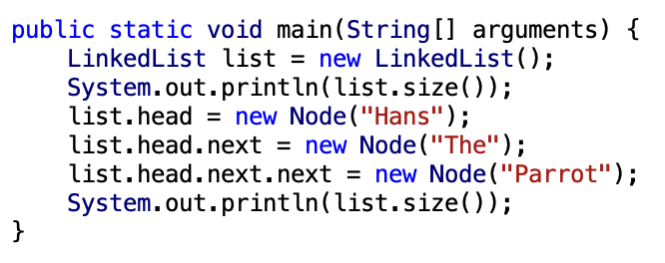

Slide 31
implement Node and LinkedList

Slide 32
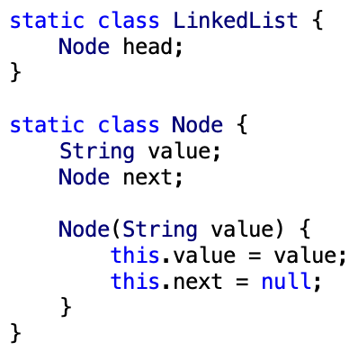

Slide 33
implement size()

Slide 34
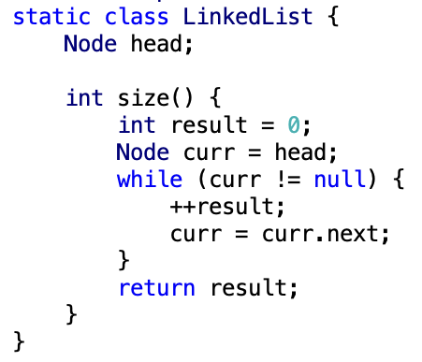

Slide 35
all code

Slide 36
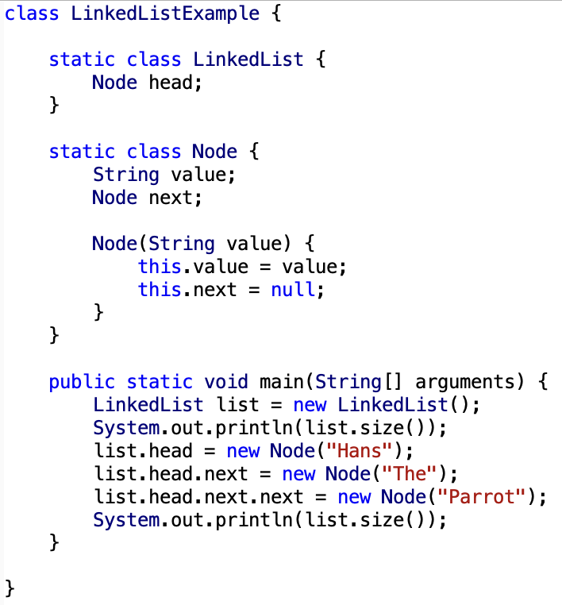

Slide 37
ANNOUNCEMENTS it's snowing! ☃️
WARMUP for a linked list, recalculating size() is O(n)
- why?
- how could you make size() (or perhaps... size) O(1)?
-- is this spooky in any way?👻
TODAY linked list big O, garbage collection preview 🚛

Slide 38
☃️

Slide 39
record LEC 02

Slide 40
size()
how would implement this method?
start out with...
curr = head
result = 0
while curr not null... ++result and set curr = curr.next
what is the big O runtime of this method?
O(n) ☹️
this seems like a pretty steep cost to pay just to know the list’s size... what would be a more efficient approach?
store size as an instance variable
update it every time you change the number of elements in the list (inside of add, remove, etc.)
what is the runtime of this approach?
O(1) 🙂

Slide 41
while way more efficient, this approach is perhaps a bit spooky 👻 a whole bunch of different functions now have to modify the instance variable size (mess up, and functions that use size will be very weirdly broken) maybe... start out with size() as a function, get everything working perfectly, and then (very carefully) rewrite size as an instance variable note: none of the homework problems require you to know the size of the list

Slide 42
link lsssssst

Slide 43
🐍
3.0
head
|
|
head.next
|
|
|
|
|
null

Slide 44
addFront(value) // add(0, value)

Slide 45
addFront(2.0)
3.0
4.0
head

Slide 46
addFront(2.0)
Node tmp = new Node(2.0);
2.0 | null
3.0
4.0
tmp
head

Slide 47
addFront(2.0)
2.0 | null
3.0
4.0
tmp
head

Slide 48
addFront(2.0)
tmp.next = head;
2.0
3.0
4.0
tmp
head

Slide 49
addFront(2.0)
2.0
3.0
4.0
tmp
head

Slide 50
addFront(2.0)
head
head = tmp;
2.0
3.0
4.0
tmp

Slide 51
addFront(2.0)
head
2.0
3.0
4.0
tmp

Slide 52
addFront(2.0)
head
2.0
3.0
4.0
// tmp leaves scope
tmp

Slide 53
addFront(2.0)
head
2.0
3.0
4.0

Slide 54
same thing but with labels instead of arrows for head and tmp

Slide 55
addFront(2.0)
head
3.0
4.0

Slide 56
addFront(2.0)
Node tmp = new Node(2.0);
tmp
head
2.0 | null
3.0
4.0

Slide 57
addFront(2.0)
tmp
head
2.0 | null
3.0
4.0

Slide 58
addFront(2.0)
tmp.next = head;
tmp
head
2.0
3.0
4.0

Slide 59
addFront(2.0)
tmp
head
2.0
3.0
4.0

Slide 60
addFront(2.0)
head = tmp;
head
2.0
3.0
4.0

Slide 61
addFront(2.0)
head
2.0
3.0
4.0

Slide 62
head
2.0
3.0
4.0

Slide 63
2.0
3.0
4.0
(even) more abstract diagram

Slide 64
example to try on paper

Slide 65
example
Node snap = new Node(1.0);
Node crackle = new Node(2.0);
Node pop = new Node(3.0);
snap.next = crackle;
crackle.next = pop;
pop.next = head;
head = snap;
4.0
5.0
head

Slide 66
example
Node snap = new Node(1.0);
Node crackle = new Node(2.0);
Node pop = new Node(3.0);
snap.next = crackle;
crackle.next = pop;
pop.next = head;
head = snap;
4.0
5.0
head

Slide 67
example
Node snap = new Node(1.0);
Node crackle = new Node(2.0);
Node pop = new Node(3.0);
snap.next = crackle;
crackle.next = pop;
pop.next = head;
head = snap;
snap
1.0 | null
4.0
5.0
head

Slide 68
example
Node snap = new Node(1.0);
Node crackle = new Node(2.0);
Node pop = new Node(3.0);
snap.next = crackle;
crackle.next = pop;
pop.next = head;
head = snap;
snap
crackle
1.0 | null
2.0 | null
4.0
5.0
head

Slide 69
example
Node snap = new Node(1.0);
Node crackle = new Node(2.0);
Node pop = new Node(3.0);
snap.next = crackle;
crackle.next = pop;
pop.next = head;
head = snap;
snap
crackle
pop
1.0 | null
2.0 | null
3.0 | null
4.0
5.0
head

Slide 70
example
Node snap = new Node(1.0);
Node crackle = new Node(2.0);
Node pop = new Node(3.0);
snap.next = crackle;
crackle.next = pop;
pop.next = head;
head = snap;
snap
crackle
pop
1.0
2.0 | null
3.0 | null
4.0
5.0
head

Slide 71
example
Node snap = new Node(1.0);
Node crackle = new Node(2.0);
Node pop = new Node(3.0);
snap.next = crackle;
crackle.next = pop;
pop.next = head;
head = snap;
snap
crackle
pop
1.0
2.0
3.0 | null
4.0
5.0
head

Slide 72
example
Node snap = new Node(1.0);
Node crackle = new Node(2.0);
Node pop = new Node(3.0);
snap.next = crackle;
crackle.next = pop;
pop.next = head;
head = snap;
snap
crackle
pop
1.0
2.0
3.0
4.0
5.0
head

Slide 73
example
Node snap = new Node(1.0);
Node crackle = new Node(2.0);
Node pop = new Node(3.0);
snap.next = crackle;
crackle.next = pop;
pop.next = head;
head = snap;
snap
crackle
pop
1.0
2.0
3.0
4.0
5.0
head

Slide 74
example
Node snap = new Node(1.0);
Node crackle = new Node(2.0);
Node pop = new Node(3.0);
snap.next = crackle;
crackle.next = pop;
pop.next = head;
head = snap;
1.0
2.0
3.0
4.0
5.0
head

Slide 75
was that faster than calling addFront() over and over? same big O or different big O?

Slide 76
was that faster than calling addFront() over and over? yes (only updated head once) same big O or different big O? same (still have to "hook up" O(n) references)

Slide 77
doubly-linked list

Slide 78
singly-linked list
head
class LinkedList {
Node head;
}
class Node {
double value;
Node next;
}

Slide 79
doubly-linked list
tail
head
class LinkedList2 {
Node2 head;
Node2 tail;
}
class Node2 {
double value;
Node2 next;
Node2 prev;
}

Slide 80
🤷
3.0
4.0
5.0

Slide 81
3.0
4.0
5.0

Slide 82
runtimes

Slide 83
singly-linked list runtimes
head
list.add(index, value)
// O(n)
list.removeByIndex(index)
// O(n)
list.size()
// O(n)
list.addFront() // list.add(0, value)
// O(1)
list.removeFront() // list.removeByIndex(0)
// O(1)
list.addBack()
// O(n)
list.removeBack()
// O(n)

Slide 84
doubly-linked list runtimes
tail
head
list.add(index, value)
// O(n)
list.removeByIndex(index)
// O(n)
list.size()
// O(n)
list.addFront()
// O(1)
list.removeFront()
// O(1)
list.addBack()
// O(1)
list.removeBack()
// O(1)

Slide 85
a doubly-linked list is a great way to implement a deque (double-ended queue)
O(1) addFront() O(1) removeFront() O(1) addBack() O(1) removeBack()
🧠 could you pull this off with an array list?
no.
addFront() is O(n)
🧠 could you pull this off with an array?
actually yes! (at least if you mean amortized runtime – resizing is O(n))

Slide 86
array deque (implementing a double-ended queue using an array)
just one idea: store list in the middle of the array
[ null, null, null, null, null, null, null, null, null, null ]
// addFront(1.0)
[ null, null, null, null, 1.0, null, null, null, null, null ]
// addFront(2.0)
[ null, null, null, 2.0, 1.0, null, null, null, null, null ]
// addFront(3.0)
[ null, null, 3.0, 2.0, 1.0, null, null, null, null, null ]
// addBack(4.0)
[ null, null, 3.0, 2.0, 1.0, 4.0, null, null, null, null ]
// removeFront()
[ null, null, null, 2.0, 1.0, 4.0, null, null, null, null ]
could also treat the array as circular (using % or floorMod)

Slide 87
remove

Slide 88
remove
prev
curr
curr.next
3.0
4.0
5.0
Node prev = null; // the previous node
Node curr = head; // the current node
while (...) {
...
prev = curr;
curr = curr.next;
}

Slide 89
remove
prev
curr
curr.next
3.0
4.0
5.0

Slide 90
remove
prev
curr
curr.next
3.0
4.0
5.0

Slide 91
remove
prev.next = curr.next;
prev
curr
curr.next
3.0
4.0
5.0

Slide 92
remove
prev.next = curr.next;
prev
curr
curr.next
3.0
4.0
5.0

Slide 93
remove
prev.next = curr.next;
prev
curr.next
3.0
5.0

Slide 94
remove
3.0
5.0

Slide 95
remove
3.0
5.0

Slide 96
where did the middle node go? - way back when...we created it using new - then we just like..."stopped referring to it" - is it gone now? 😥

Slide 97
answer: yes / sorta-kinda (at least in Java)

Slide 98
switch to Windows Laptop - garbage collection motivation - extra time: MD5 hash (review from last week)

Slide 99
ANNOUNCEMENTS☃️
colloquium (alumni panel) today! juggling club after colloquium!
WARMUP imagine you have n circles
how do you answer the querstion "are there any collisions?"
what is the worst case big O runtime
TODAY review, memory 🚛, memory in C

Slide 100
quadtrees preview

Slide 101
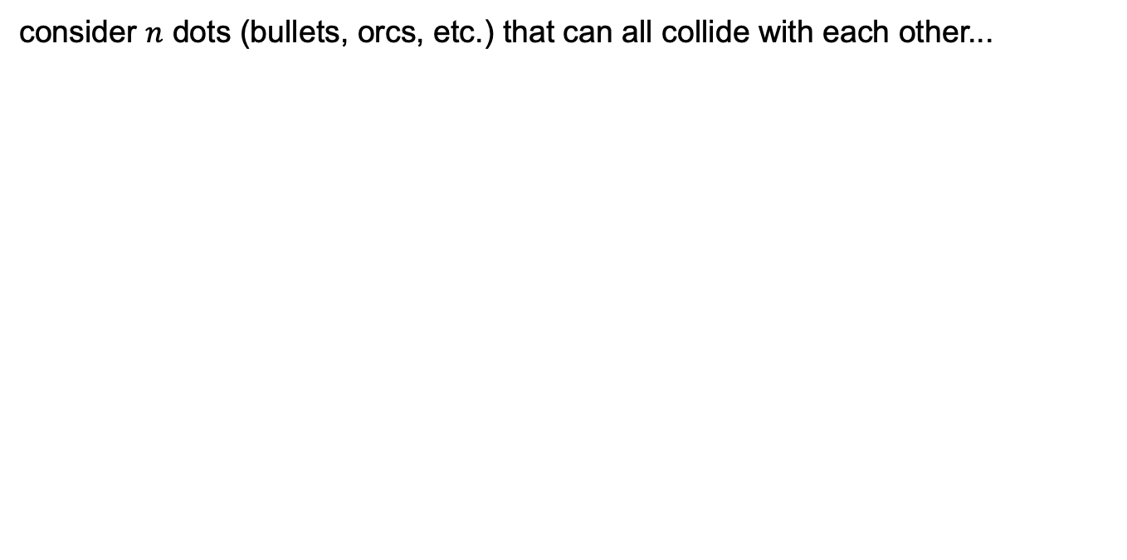
problem: collision detection
consider $n$ dots (bullets, orcs, etc.) that can all collide with each other...

Slide 102
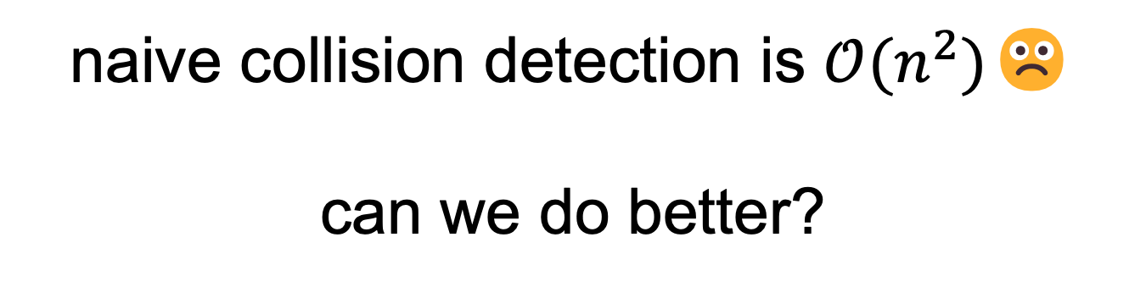
naive collision detection is $𝒪(n^{2})$☹️ can we do better?

Slide 103
problem: collision detection
consider $n$ dots (bullets, orcs, etc.) that can all collide with each other...

Slide 104
problem: collision detection
consider $n$ dots (bullets, orcs, etc.) that can all collide with each other...

Slide 105
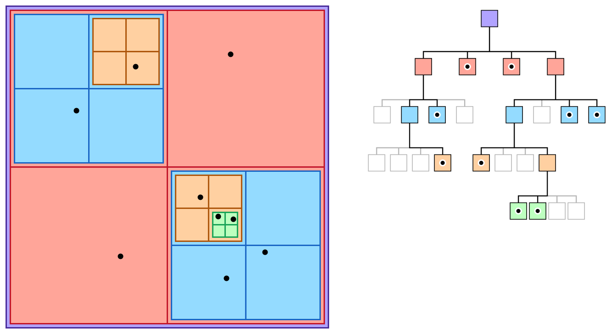
yes 🙂 this is called a quadtree

Slide 106
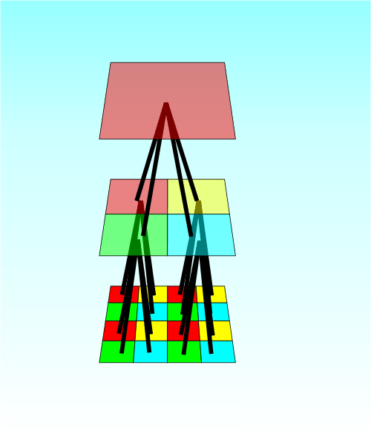

Slide 107
james-bern.github.io
open the Best Stack Overflow Answer of All Time
answer...
what does user4842163 do for work?
what is their test case?
how fast is their fastest algorithm?
does their algorithm have any interesting features?

Slide 108
record LEC 02

Slide 109
review prepend example & array deque

Slide 110
review: prepending a list

Slide 111
example
Node snap = new Node(1.0);
Node crackle = new Node(2.0);
Node pop = new Node(3.0);
snap.next = crackle;
crackle.next = pop;
pop.next = head;
head = snap;
4.0
5.0
head

Slide 112
example
Node snap = new Node(1.0);
Node crackle = new Node(2.0);
Node pop = new Node(3.0);
snap.next = crackle;
crackle.next = pop;
pop.next = head;
head = snap;
4.0
5.0
head

Slide 113
example
Node snap = new Node(1.0);
Node crackle = new Node(2.0);
Node pop = new Node(3.0);
snap.next = crackle;
crackle.next = pop;
pop.next = head;
head = snap;
snap
1.0 | null
4.0
5.0
head

Slide 114
example
Node snap = new Node(1.0);
Node crackle = new Node(2.0);
Node pop = new Node(3.0);
snap.next = crackle;
crackle.next = pop;
pop.next = head;
head = snap;
snap
crackle
1.0 | null
2.0 | null
4.0
5.0
head

Slide 115
example
Node snap = new Node(1.0);
Node crackle = new Node(2.0);
Node pop = new Node(3.0);
snap.next = crackle;
crackle.next = pop;
pop.next = head;
head = snap;
snap
crackle
pop
1.0 | null
2.0 | null
3.0 | null
4.0
5.0
head

Slide 116
example
Node snap = new Node(1.0);
Node crackle = new Node(2.0);
Node pop = new Node(3.0);
snap.next = crackle;
crackle.next = pop;
pop.next = head;
head = snap;
snap
crackle
pop
1.0
2.0 | null
3.0 | null
4.0
5.0
head

Slide 117
example
Node snap = new Node(1.0);
Node crackle = new Node(2.0);
Node pop = new Node(3.0);
snap.next = crackle;
crackle.next = pop;
pop.next = head;
head = snap;
snap
crackle
pop
1.0
2.0
3.0 | null
4.0
5.0
head

Slide 118
example
Node snap = new Node(1.0);
Node crackle = new Node(2.0);
Node pop = new Node(3.0);
snap.next = crackle;
crackle.next = pop;
pop.next = head;
head = snap;
snap
crackle
pop
1.0
2.0
3.0
4.0
5.0
head

Slide 119
example
Node snap = new Node(1.0);
Node crackle = new Node(2.0);
Node pop = new Node(3.0);
snap.next = crackle;
crackle.next = pop;
pop.next = head;
head = snap;
snap
crackle
pop
1.0
2.0
3.0
4.0
5.0
head

Slide 120
example
Node snap = new Node(1.0);
Node crackle = new Node(2.0);
Node pop = new Node(3.0);
snap.next = crackle;
crackle.next = pop;
pop.next = head;
head = snap;
1.0
2.0
3.0
4.0
5.0
head

Slide 121
review: double-ended queue implementations

Slide 122
a doubly-linked list is a great way to implement a deque (double-ended queue)
O(1) addFront() O(1) removeFront() O(1) addBack() O(1) removeBack()
🧠 could you pull this off easily with Java's ArrayList?
no.
addFront() and removeFront() are both O(n) (we have to "move everything else over")
🧠 could you pull this off with just an array (or your own special array list)?
actually yes! (at least if you mean amortized runtime – resizing is O(n))

Slide 123
array deque (implementing a double-ended queue using an array)
TODO: replace line with nextFront and nextBack
just one idea: store list in the middle of the array
[ null, null, null, null, null, null, null, null, null, null ]
// addBack(1.0)
[ null, null, null, null, 1.0, null, null, null, null, null ]
// addBack(2.0)
[ null, null, null, 2.0, 1.0, null, null, null, null, null ]
// addBack(3.0)
[ null, null, 3.0, 2.0, 1.0, null, null, null, null, null ]
// addFront(4.0)
[ null, null, 3.0, 2.0, 1.0, 4.0, null, null, null, null ]
// removeBack()
[ null, null, null, 2.0, 1.0, 4.0, null, null, null, null ]
could also treat the array as circular (using % or floorMod)

Slide 124
review: type

Slide 125
variables in Java have a specified type
# okay in Python
foo = 7 # foo is an int
foo = False # now, foo is a boolean
// NOT okay in Java
int foo = 7; // foo is an int
foo = false; // Error: incompatible types:
// boolean cannot be converted to int

Slide 126
in Java, declaring and initializing variables are separate things
// Option A: two lines int foo; // declare a variable foo of type int foo = 7; // initialize foo to 7
// Option B: one line int foo = 7; // declare int foo and initialize it to 7

Slide 127
memory

Slide 128
note: i am intentionally breaking these examples into many steps to teach you about memory don't actually code this way! int foo = 7; // <-- Good!

Slide 129
"the stack"
local variable primitives & references to Objects
undefined by default (will NOT compile if used)
"the heap"
the actual Objects (arrays and String's count as Objects)
cleared to 0 or null by default

Slide 130
basic example int a is a primitive int[] b is a reference to an array

Slide 131
"the stack"
local variable primitives & references to Objects
undefined by default (will NOT compile if used)
"the heap"
the actual Objects (arrays and String's count as Objects)
cleared to 0 or null by default

Slide 132
{
int a = 7;
int[] b = new int[5];
b[0] = 3;
}

Slide 133
{
int a;
a = 7;
int[] b;
b = new int[5];
b[0] = 3;
}

Slide 134
{
int a;
a = 7;
int[] b;
b = new int[5];
b[0] = 3;
}

Slide 135
{
int a;
a = 7;
int[] b;
b = new int[5];
b[0] = 3;
}
a
UNDEFINED

Slide 136
{
int a;
a = 7;
int[] b;
b = new int[5];
b[0] = 3;
}
a
7

Slide 137
{
int a;
a = 7;
int[] b;
b = new int[5];
b[0] = 3;
}
a
b
7
UNDEFINED

Slide 138
{
int a;
a = 7;
int[] b;
b = new int[5];
b[0] = 3;
}
a
b
7
0x0a2bcefa
0 0 0 0 0

Slide 139
{
int a;
a = 7;
int[] b;
b = new int[5];
b[0] = 3;
}
a
b
7
0x0a2bcefa
0 0 0 0 0

Slide 140
{
int a;
a = 7;
int[] b;
b = new int[5];
b[0] = 3;
}
a
b
7
0x0a2bcefa
3 0 0 0 0

Slide 141
{
int a;
a = 7;
int[] b;
b = new int[5];
b[0] = 3;
}
a
b
7
0x0a2bcefa
3 0 0 0 0

Slide 142
{
int a;
a = 7;
int[] b;
b = new int[5];
b[0] = 3;
}
3 0 0 0 0

Slide 143
{
int a;
a = 7;
int[] b;
b = new int[5];
b[0] = 3;
}
3 0 0 0 0

Slide 144
{
int a;
a = 7;
int[] b;
b = new int[5];
b[0] = 3;
}
3 0 0 0 0
🚛

Slide 145
{
int a;
a = 7;
int[] b;
b = new int[5];
b[0] = 3;
}

Slide 146
linked list (from HW-08) example

Slide 147
singly-linked list
head
class LinkedList {
Node head;
}
class Node {
String value;
Node next;
}

Slide 148
"the stack"
local variable primitives & references to Objects
undefined by default (will NOT compile if used)
"the heap"
the actual Objects (arrays and String's count as Objects)
cleared to 0 or null by default

Slide 150
LinkedList list =
new LinkedList("Hans -> Parrot");

Slide 151
LinkedList list;
{
Node node;
String string;
list = new LinkedList();
node = new Node();
string = "Hans";
node.value = string;
list.head = node;
node = new Node();
string = "Parrot";
node.value = string;
list.head.next = node;
}

Slide 152
LinkedList list;
{
Node node;
String string;
list = new LinkedList();
node = new Node();
string = "Hans";
node.value = string;
list.head = node;
node = new Node();
string = "Parrot";
node.value = string;
list.head.next = node;
}
list
UNDEFINED

Slide 153
LinkedList list;
{
Node node;
String string;
list = new LinkedList();
node = new Node();
string = "Hans";
node.value = string;
list.head = node;
node = new Node();
string = "Parrot";
node.value = string;
list.head.next = node;
}
list
node
UNDEFINED
UNDEFINED

Slide 154
LinkedList list;
{
Node node;
String string;
list = new LinkedList();
node = new Node();
string = "Hans";
node.value = string;
list.head = node;
node = new Node();
string = "Parrot";
node.value = string;
list.head.next = node;
}
list
node
string
UNDEFINED
UNDEFINED
UNDEFINED

Slide 155
LinkedList list;
{
Node node;
String string;
list = new LinkedList();
node = new Node();
string = "Hans";
node.value = string;
list.head = node;
node = new Node();
string = "Parrot";
node.value = string;
list.head.next = node;
}
list
node
string
0x11111111
UNDEFINED
UNDEFINED
null

Slide 156
LinkedList list;
{
Node node;
String string;
list = new LinkedList();
node = new Node();
string = "Hans";
node.value = string;
list.head = node;
node = new Node();
string = "Parrot";
node.value = string;
list.head.next = node;
}
list
node
string
0x11111111
0x22222222
UNDEFINED
null
null null

Slide 157
LinkedList list;
{
Node node;
String string;
list = new LinkedList();
node = new Node();
string = "Hans";
node.value = string;
list.head = node;
node = new Node();
string = "Parrot";
node.value = string;
list.head.next = node;
}
list
node
string
0x11111111
0x22222222
0x88888888
null
null null
H a n s

Slide 158
LinkedList list;
{
Node node;
String string;
list = new LinkedList();
node = new Node();
string = "Hans";
node.value = string;
list.head = node;
node = new Node();
string = "Parrot";
node.value = string;
list.head.next = node;
}
list
node
string
0x11111111
0x22222222
0x88888888
null
0x88888888 null
H a n s

Slide 159
LinkedList list;
{
Node node;
String string;
list = new LinkedList();
node = new Node();
string = "Hans";
node.value = string;
list.head = node;
node = new Node();
string = "Parrot";
node.value = string;
list.head.next = node;
}
list
node
string
0x11111111
0x22222222
0x88888888
0x22222222
0x88888888 null
H a n s

Slide 160
LinkedList list;
{
Node node;
String string;
list = new LinkedList();
node = new Node();
string = "Hans";
node.value = string;
list.head = node;
node = new Node();
string = "Parrot";
node.value = string;
list.head.next = node;
}
list
node
string
0x11111111
0x33333333
0x88888888
0x22222222
0x88888888 null
null null
H a n s

Slide 161
LinkedList list;
{
Node node;
String string;
list = new LinkedList();
node = new Node();
string = "Hans";
node.value = string;
list.head = node;
node = new Node();
string = "Parrot";
node.value = string;
list.head.next = node;
}
list
node
string
0x11111111
0x33333333
0x99999999
0x22222222
0x88888888 null
null null
H a n s
P a r r o t

Slide 162
LinkedList list;
{
Node node;
String string;
list = new LinkedList();
node = new Node();
string = "Hans";
node.value = string;
list.head = node;
node = new Node();
string = "Parrot";
node.value = string;
list.head.next = node;
}
list
node
string
0x11111111
0x33333333
0x99999999
0x22222222
0x88888888 null
0x99999999 null
H a n s
P a r r o t

Slide 163
LinkedList list;
{
Node node;
String string;
list = new LinkedList();
node = new Node();
string = "Hans";
node.value = string;
list.head = node;
node = new Node();
string = "Parrot";
node.value = string;
list.head.next = node;
}
list
node
string
0x11111111
0x33333333
0x99999999
0x22222222
0x88888888 0x33333333
0x99999999 null
H a n s
P a r r o t

Slide 164
LinkedList list;
{
Node node;
String string;
list = new LinkedList();
node = new Node();
string = "Hans";
node.value = string;
list.head = node;
node = new Node();
string = "Parrot";
node.value = string;
list.head.next = node;
}
list
0x11111111
0x22222222
0x88888888 0x33333333
0x99999999 null
H a n s
P a r r o t

Slide 165
LinkedList list;
{
Node node;
String string;
list = new LinkedList();
node = new Node();
string = "Hans";
node.value = string;
list.head = node;
node = new Node();
string = "Parrot";
node.value = string;
list.head.next = node;
}
list
0x11111111
0x22222222
0x88888888 0x33333333
0x99999999 null
H a n s
P a r r o t

Slide 166
memory in C

Slide 167
in C, we often get to choose whether to allocate memory on the stack or the heap

Slide 168
memory allocation
// Java
int[] heapAllocatedArray = new int[10]
heapAllocatedArray[0] = 3;
// C
int stackAllocatedArray[10];
int *heapAllocatedArray = malloc(10000000 * sizeof(int));
stackAllocatedArray[0] = 3;
heapAllocatedArray[0] = 3;
free(heapAllocatedArray);

Slide 169
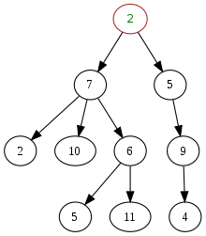
ANNOUNCEMENTS☃️
how is the linked list hw?
today is "We Ran Out of Time For Kahoot Friday" Monday!
WARMUP - here is a tree: what are some uses of trees?
- Kahoooot!
TODAY for-each loops, directed graphs & trees

Slide 170
🦉

Slide 171
record LEC-02

Slide 172
~review

Slide 173
for-each loop

Slide 174
🐍 Python's for loop is a for-each loop
lst = [ True, 5.0, "Hello" ]
for element in lst: # for each item in the list...
print(element)

Slide 175
a for-each loop can be a convenient alternative to a for loop
for (int turretIndex = 0; turretIndex < turrets.length; ++turretIndex) {
Turret turret = turrets[turretIndex];
...
}
for (Turret turret : turrets) { // for each turret in turrets...
...
}

Slide 176
a for-each loop can be a convenient alternative to a for loop
for (int strokeIndex = 0; strokeIndex < currentFrame.size(); ++strokeIndex) {
ArrayList<Vector2> stroke = currentFrame.get(strokeIndex);
for (int pointIndex = 0; pointIndex < stroke.size(); ++pointIndex) {
Vector2 point = stroke.get(pointIndex);
...
}
}
for (ArrayList<Vector2> stroke : currentFrame) {
for (Vector2 point : stroke) {
...
}
}

Slide 177
for-each loop
a for-each loop can be a convenient alternative to a for loop
you never *need* a for-each loop
can always "fall back to" a for loop with an index
☠ for-each loops have the same dangers as "convenient references"
for (int turretIndex = 0; turretIndex < turrets.length; ++turretIndex) {
Turret turret = turrets[turretIndex]; // convenient reference
...
}
for (Turret turret : turrets) { // convenient reference
...
}

Slide 178
turrets = new Turret[100]; for (Turret turret : turrets) { // turret is NOT the same reference as in the turrets array turret = new Turret(); } turrets[0].position = new Vector2(40.0, 0.0); // turrets[0] is still null; this will crash
turret
turrets
0x00000002
0x00000010
null
null
0.0, 0.0
0
0.0, 0.0
null
null
0x00000000
0x00000003
0x00000013
0x00000001
0x00000002
0x00000010
0x00000011
0x00000004
0x00000007
0x0000000b
0x00000012
0x00000005
0x00000006
0x00000008
0x00000009
0x0000000a
0x00000014
0x0000000c
0x0000000f
0x00000015
0x0000000d
0x0000000e

Slide 179
for-each loop
in Java, a for-each loop can iterate through String's with toCharArray()
☠ toCharArray() is O(n), but fine for CSCI 136
for (char c : string.toCharArray()) {
...
}

Slide 180
directed graphs & trees

Slide 181
TODO (Jim): Talk about math.

Slide 182
directed graph

Slide 183
a directed graph is a super general linked list
a node in a graph can have references to any number of other nodes
nodes are drawn as circles
references are drawn as arrows

Slide 184
(directed) tree

Slide 185
trees use kinship terms
a node has references to other nodes
it is their parent
they are its children

Slide 186
a tree is a graph that...
has exactly one node with zero parents (the root)
has no nodes with more than one parent
has no cycles (loops)
is connected (just one tree, not multiple disconnected trees)
5
16
2
2
2
13
18
1
4
11
15
19

Slide 187
time for everyone's favorite home game...

Slide 188
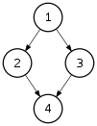
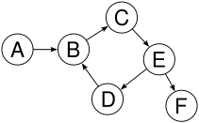
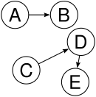

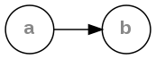
is it a tree?
yes
no
violates 2 & 3
tree rules
one node with zero parents
no node with more than one parent
no cycles
is connected
no
violates 2 & 3
no
violates 1 & 4
no
violates 1 & 3
yes

Slide 189
is it a tree?
yes

Slide 190

can be seen as

Slide 191
uses of trees

Slide 192
simplifying expressions

Slide 193
(2 + 3)
* 4
*
+
4
2
3

Slide 194
5
* 4
*
5
4

Slide 195
20
20

Slide 196
!
(true && )
(false || true)
!
&&
true
||
false
true

Slide 197
!
(true && true)
!
&&
true
true

Slide 198
!true
!
true

Slide 199
false
false

Slide 200
and so much more!

Slide 201
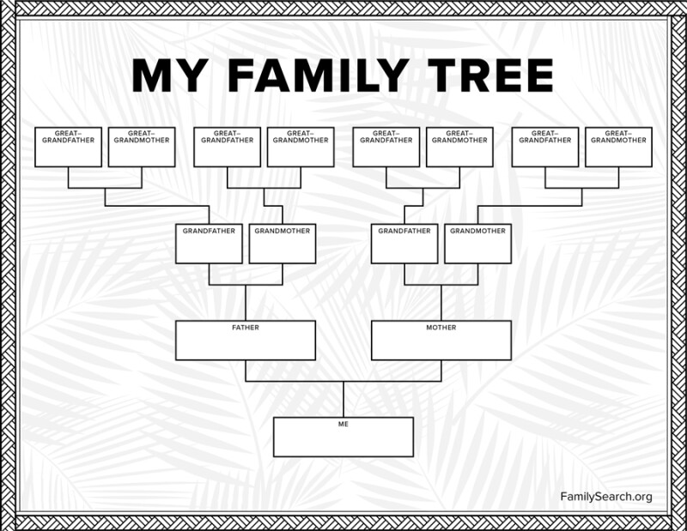

Slide 202
jim
careful: these nodes are
the children of the node with value jim
jim's mom
jim's dad
jim's mom's mom
jim's mom's dad
jim's dad's mom
jim's dad's dad

Slide 203
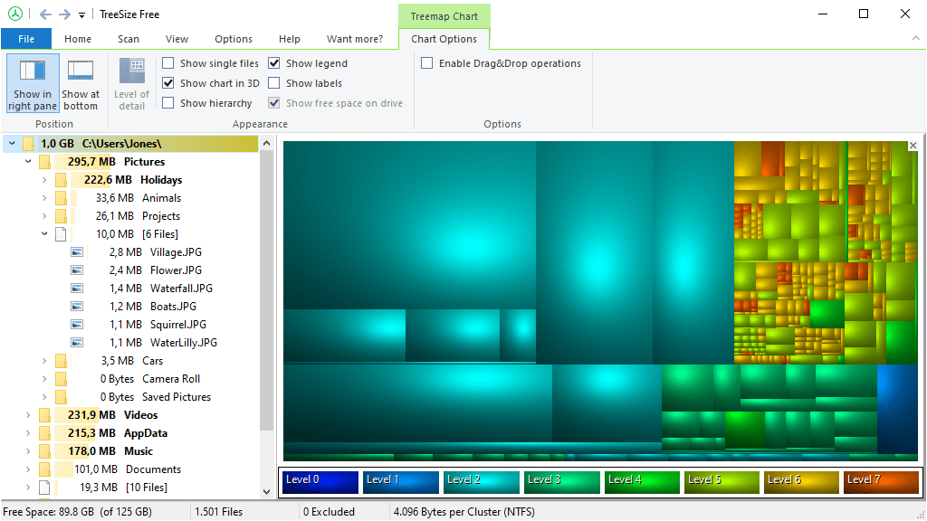
File System (TreeSize Free)
https://www.jam-software.com/treesize_free

Slide 204
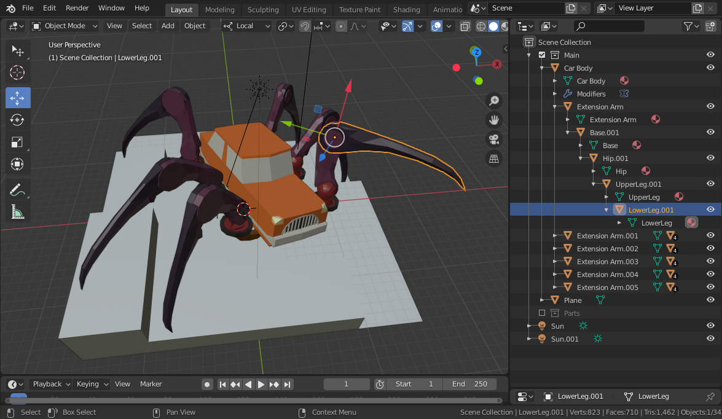
Transformation Hierarchy (Blender)
https://15466.courses.cs.cmu.edu/lesson/hierarchy

Slide 205
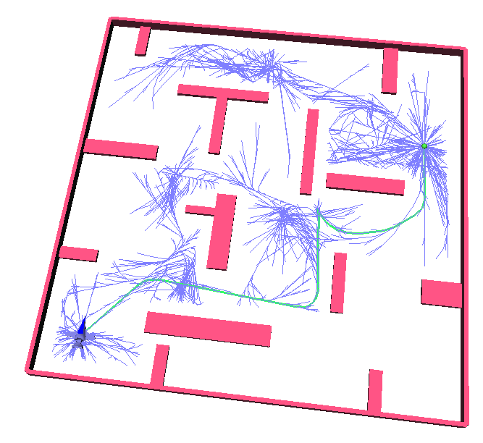
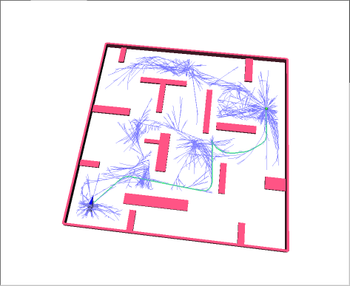
Rapidly Exploring Random Trees (RRTs)
Randomized Kinodynamic Planning by Steven M. LaValle and James J. Kuffner, Jr., International Journal of Robotics Research, 20(5):378--400, May 2001

Slide 206
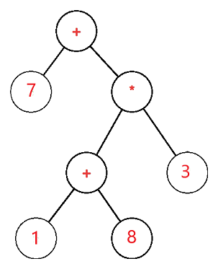
*
ANNOUNCEMENTS
today is Laptop Wednesday
WARMUP evaluate this expression tree
TODAY
tree terminology and a terrific tree traversal tutorial

Slide 207
record LEC-02

Slide 208
tree terminology

Slide 209
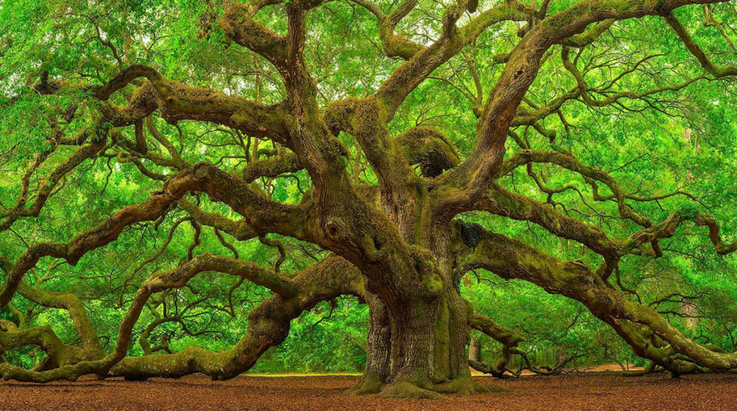

Slide 211
the root has no parents a leaf has no children
root
5
16
2
13
18
leaves

Slide 212
a path is a chain of distinct edges
16
path
13
18

Slide 213
a node's depth is the number of edges in the path from the root to that node
depth 0
5
16
depth 1
2
13
18
depth 2
depth 3

Slide 214
level means either depth or (depth + 1) depending on who you ask 🤷‍♀️

Slide 215
tree traversal

Slide 216
let us first experience tree traversal visually

Slide 217
switch slide deck

Slide 218
breadth-first vs. (pre-order) depth-first
0
0
1
2
3
1
2
3
4
5
4
5
6
6
0
1
2
3
4
5
6
0
1
4
6
5
2
3

Slide 219
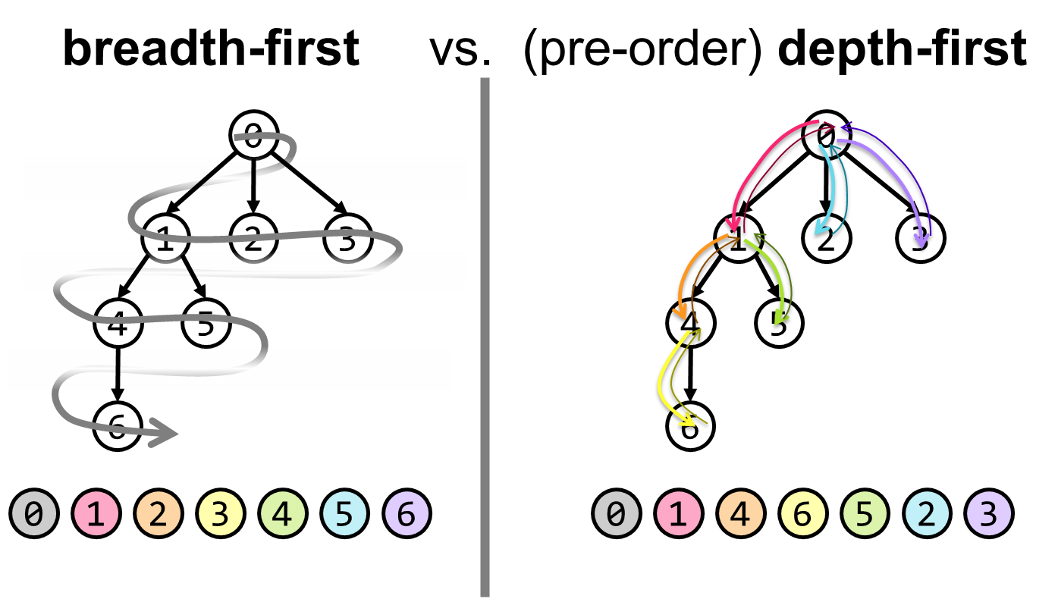
tree traversal (walking the tree)
tree traversal means iterating through all of the tree's nodes
breadth-first explores as broadly (widely) as possible
one level (depth) at a time
uses a queue
depth-first explores as deeply as possible
one root-to-leaf path at a time
uses a stack (or recursion, which uses the callstack)
☠ there are actually 6 subtly different variants of depth-first traversal (i will explain them when we get to binary trees)

Slide 220
why might we want to traverse a tree? why did we want to traverse a linked list? do we every *traverse* an array?

Slide 221
gathering all words in a trie (HW09)
searching for something (HW10?)
evaluating an expression tree
gathering all the nodes into a list (Tut09)

Slide 222
Terrific Tree Traversal Tutorial

Slide 223
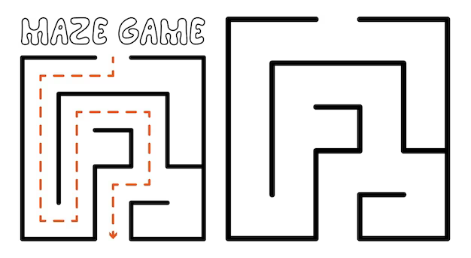

ANNOUNCEMENTS
today is Fun Friday?
WARMUP vibes seem low, so here is
an extra a-MAZE-ing warmup
draw this maze as a tree
TODAY
tree traversal wrapup; quadtree reading
start
finish

Slide 224
record LEC-02

Slide 225
start
finish

Slide 254
...

Slide 257
ANNOUNCEMENTS
today is Fun Friday?
WARMUP vibes seem low, so here is
an extra a-MAZE-ing warmup
draw this maze as a tree
TODAY
tree traversal wrapup; quadtree reading
start
finish

Slide 258
worms world party example

Slide 259
tree traversal

Slide 260


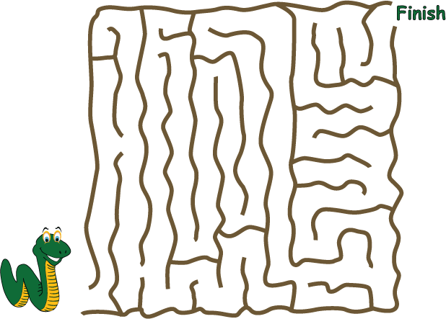
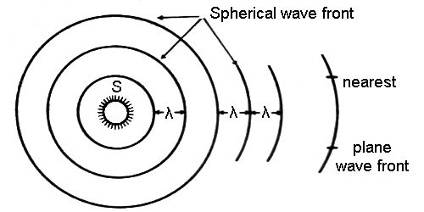
breadth-first vs. (pre-order) depth-first
"a persistent, optimistic, very thorough worm" –Mark Hopkins

Slide 261
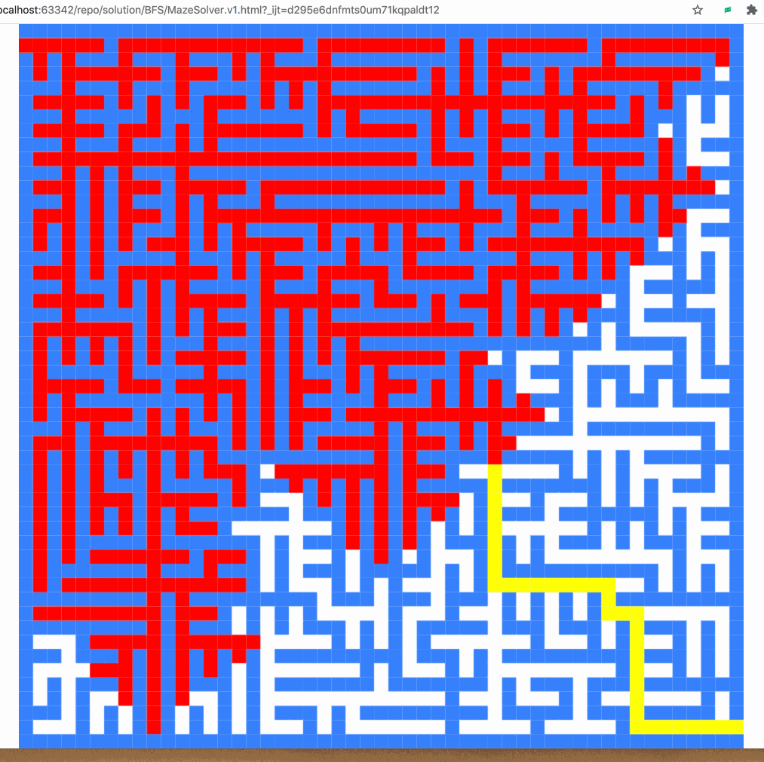
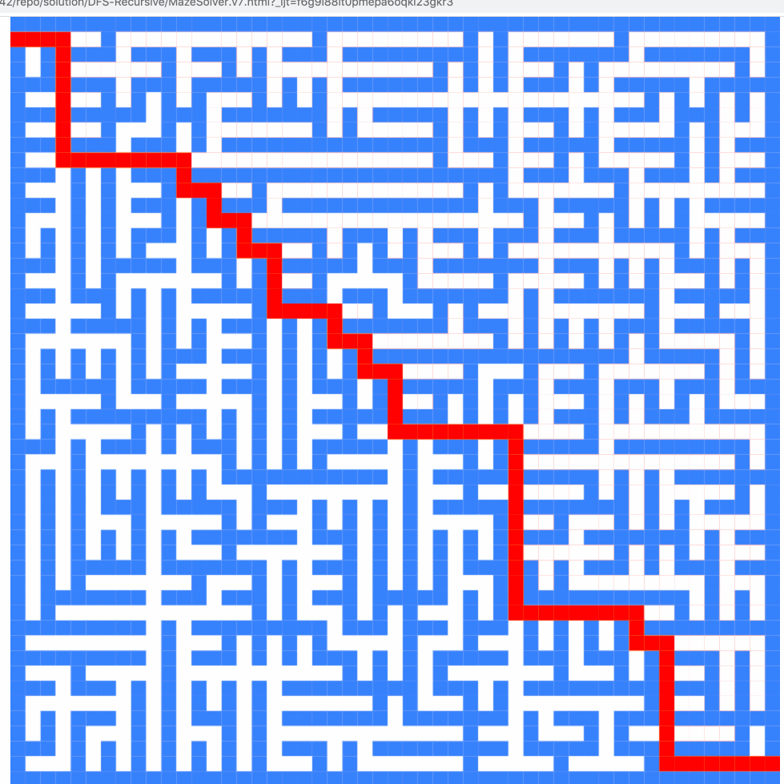
breadth-first vs. (pre-order) depth-first

Slide 262
breadth-first vs. (pre-order) depth-first
0
0
1
2
3
1
2
3
4
5
4
5
6
6
0
1
2
3
4
5
6
0
1
4
6
5
2
3

Slide 263
(switch slide deck)

Slide 264
Tree Tutorial continued

Slide 265
traverseBreadthFirst
0
0 added to queue
0 removed from queue
1 added to queue
2 added to queue
3 added to queue
1 removed from queue
4 added to queue
5 added to queue
2 removed from queue
3 removed from queue
6 added to queue
4 removed from queue
5 removed from queue
6 removed from queue
7 added to queue
7 removed from queue
1
2
3
4
5
6
queue.add(root)
while queue not empty:
curr = queue.remove()
... # process curr
for child in curr.children:
queue.add(child)
7
0
1
2
3
4
5
6
7

Slide 266
traversePreOrderDepthFirst
change color to indicate
hasBeenVisited = true
start recurse(0)
start recurse(1)
start recurse(4)
finish recurse(4)
start recurse(5)
finish recurse(5)
finish recurse(1)
start recurse(2)
finish recurse(2)
start recurse(3)
start recurse(6)
start recurse(7)
finish recurse(7)
finish recurse(6)
finish recurse(3)
finish recurse(0)
0
1
2
3
4
5
6
def recurse(curr):
... # process curr
for child in curr.children:
recurse(child)
7
recurse(root)
0
1
4
5
2
3
6
7

Slide 267
quadtree rabbit hole 🐰

Slide 268
problem: naive collision detection is slow O(n^2) to check all pairs

Slide 269
idea: use a grid O(n) to assign all circles to grid cells

Slide 270
problem: so many grid cells; most empty!

Slide 271
idea: "only have grid where you need it"

Slide 272
problem: how do we store this?

Slide 273
idea: a tree

Slide 274
idea: a tree

Slide 277
quadtree reading

Slide 278
ANNOUNCEMENTS
today is Pre-Recoreded Lecture Monday ☹️
see you back in person on Wednesday!
WARMUP imagine searching for a tube of toothpaste in the real world
how would find one as quickly as possible?
TODAY
binary search trees

Slide 279
binary trees

Slide 280
binary tree
in a binary tree, each node has <= 2 children
10
5
16
2
13
18
1
4
11
15
17

Slide 281
🧠 is a linked list a binary tree?

Slide 282
technically, yes all nodes have <= 2 children (tail has 0 children, all other nodes have 1 child)

Slide 283
(ordered) binary tree
each node has a left child and a right child (either or both children can be null)
10
5
16
node
13
18
11
15
17
node.leftChild
node.rightChild

Slide 284
(ordered) binary tree
each node has a left subtree and a right subtree

Slide 285
sort & search

Slide 286
sort

Slide 287
sorted
a list / array is sorted if its elements are "in order"
by convention, this means ascending order (going up from left to right)
[1, 2, 5, 6, 9, 13] is sorted
[9, 5, 1, 2, 6, 13] is unsorted (NOT sored)

Slide 288
search

Slide 289
search
to search means to look for something (in some data structure)
a simple search problem is finding a given value in an array / list // get index of the first element in array with this value // returns -1 if value not found int search(int[] array, int value) { ... }

Slide 290
linear search (of a list/array)

Slide 291
linear search
linear search looks at each element one by one
linear search works whether or not the list is sorted
linear search is O(n) (linear time)😐
// get index of the first element in array with this value // returns -1 if value not found int linearSearch(int[] array, int value) { for (int i = 0; i < array.length; ++i) { if (array[i] == value) { return i; } } return -1; }

Slide 292
example: linear search for 17 [13 2 55 7 17 100 77]

Slide 293
example: linear search for 17 [13 2 55 7 17 100 77]

Slide 294
example: linear search for 17 [13 2 55 7 17 100 77]

Slide 295
example: linear search for 17 [13 2 55 7 17 100 77]

Slide 296
example: linear search for 17 [13 2 55 7 17 100 77]

Slide 297
example: linear search for 17 [13 2 55 7 17 100 77]

Slide 298
example: linear search for 17 [13 2 55 7 17 100 77]

Slide 299
example: linear search for 17 [13 2 55 7 17 100 77]

Slide 300
example: linear search for 17 [13 2 55 7 17 100 77]

Slide 301
example: linear search for 17 [13 2 55 7 17 100 77]

Slide 302
example: linear search for 17 [13 2 55 7 17 100 77]

Slide 304
example: linear search for 17 [1 2 4 5 6 8 9 10 11 13 15 16 17 18 19]

Slide 305
example: linear search for 17 [1 2 4 5 6 8 9 10 11 13 15 16 17 18 19]

Slide 306
example: linear search for 17 [1 2 4 5 6 8 9 10 11 13 15 16 17 18 19]

Slide 307
example: linear search for 17 [1 2 4 5 6 8 9 10 11 13 15 16 17 18 19]

Slide 308
example: linear search for 17 [1 2 4 5 6 8 9 10 11 13 15 16 17 18 19]

Slide 309
example: linear search for 17 [1 2 4 5 6 8 9 10 11 13 15 16 17 18 19]

Slide 310
example: linear search for 17 [1 2 4 5 6 8 9 10 11 13 15 16 17 18 19]

Slide 311
example: linear search for 17 [1 2 4 5 6 8 9 10 11 13 15 16 17 18 19]

Slide 312
example: linear search for 17 [1 2 4 5 6 8 9 10 11 13 15 16 17 18 19]

Slide 313
example: linear search for 17 [1 2 4 5 6 8 9 10 11 13 15 16 17 18 19]

Slide 314
example: linear search for 17 [1 2 4 5 6 8 9 10 11 13 15 16 17 18 19]

Slide 315
example: linear search for 17 [1 2 4 5 6 8 9 10 11 13 15 16 17 18 19]

Slide 316
example: linear search for 17 [1 2 4 5 6 8 9 10 11 13 15 16 17 18 19]

Slide 317
example: linear search for 17 [1 2 4 5 6 8 9 10 11 13 15 16 17 18 19]

Slide 318
example: linear search for 17 [1 2 4 5 6 8 9 10 11 13 15 16 17 18 19]

Slide 319
example: linear search for 17 [1 2 4 5 6 8 9 10 11 13 15 16 17 18 19]

Slide 320
example: linear search for 17 [1 2 4 5 6 8 9 10 11 13 15 16 17 18 19]

Slide 321
example: linear search for 17 [1 2 4 5 6 8 9 10 11 13 15 16 17 18 19]

Slide 322
example: linear search for 17 [1 2 4 5 6 8 9 10 11 13 15 16 17 18 19]

Slide 323
example: linear search for 17 [1 2 4 5 6 8 9 10 11 13 15 16 17 18 19]

Slide 324
example: linear search for 17 [1 2 4 5 6 8 9 10 11 13 15 16 17 18 19]

Slide 325
example: linear search for 17 [1 2 4 5 6 8 9 10 11 13 15 16 17 18 19]

Slide 326
example: linear search for 17 [1 2 4 5 6 8 9 10 11 13 15 16 17 18 19]

Slide 327
example: linear search for 17 [1 2 4 5 6 8 9 10 11 13 15 16 17 18 19]

Slide 328
example: linear search for 17 [1 2 4 5 6 8 9 10 11 13 15 16 17 18 19]

Slide 329
example: linear search for 17 [1 2 4 5 6 8 9 10 11 13 15 16 17 18 19]

Slide 330
example: linear search for 17 [1 2 4 5 6 8 9 10 11 13 15 16 17 18 19]

Slide 331
if we know that a list is sorted... can we search it faster?

Slide 332
yes 🚀

Slide 333
binary search (of a list/array)

Slide 334
binary search
binary search "cuts the list in half" over and over
binary search only works when the list is sorted
binary search is O(log(n)) 🙂

Slide 335
example: binary search for 17 [1 2 4 5 6 8 9 10 11 13 15 16 17 18 19]

Slide 336
example: binary search for 17 [1 2 4 5 6 8 9 10 11 13 15 16 17 18 19]
10 < 17

Slide 337
example: binary search for 17 [1 2 4 5 6 8 9 10 11 13 15 16 17 18 19]

Slide 338
example: binary search for 17 [1 2 4 5 6 8 9 10 11 13 15 16 17 18 19]
16 < 17

Slide 339
example: binary search for 17 [1 2 4 5 6 8 9 10 11 13 15 16 17 18 19]

Slide 340
example: binary search for 17 [1 2 4 5 6 8 9 10 11 13 15 16 17 18 19]
17 < 18

Slide 341
example: binary search for 17 [1 2 4 5 6 8 9 10 11 13 15 16 17 18 19]

Slide 342
example: binary search for 17 [1 2 4 5 6 8 9 10 11 13 15 16 17 18 19]
17 == 17

Slide 343
example: binary search for 17 [1 2 4 5 6 8 9 10 11 13 15 16 17 18 19]

Slide 344
implementating binary search is actually pretty tricky! make sure you test thoroughly!

Slide 345
✨ hint: binary search [1 2 4 5 6 8 9 10 11 13 15 16 17 18 19]
[^ 2 4 5 6 8 9 10 11 13 15 16 17 18 ^ ]
[| 2 4 5 6 8 9 10 11 13 15 16 17 18 | ]
[i = 0 4 5 6 8 9 10 11 13 15 16 17 18 j ]

Slide 346
binary search tree

Slide 347
binary search tree
in a binary search tree (sorted binary tree) every node follows: "a node's value is greater than the values of all nodes in its left subtree and less than the values of all nodes in its right subtree"
10
5
16
2
13
18
1
4
11
15
17

Slide 348
binary search tree
in a binary search tree (sorted binary tree) every node follows: "a node's value is greater than the values of all nodes in its left subtree and less than the values of all nodes in its right subtree"
10
10 < 16
5
16
5 < 10
2 < 10
10 < 13
2
13
18
10 < 18
1
4
10 < 11
11
15
17
10 < 17
4 < 10
1 < 10
10 < 15

Slide 349
binary search tree
in a binary search tree (sorted binary tree) every node follows: "a node's value is greater than the values of all nodes in its left subtree and less than the values of all nodes in its right subtree"
10
5
16
13 < 16
2
13
18
16 < 18
1
4
11 < 16
11
15
17
16 < 17
15 < 16

Slide 350
binary search tree
in a binary search tree (sorted binary tree) every node follows: "a node's value is greater than the values of all nodes in its left subtree and less than the values of all nodes in its right subtree"
10
5
16
2
13
18
1
4
11
15
17

Slide 351
binary search (of a binary search tree)

Slide 352
binary search
binary search "cuts the tree in half" over and over
binary search only works when the binary tree is sorted (is a binary search tree)
binary search is O(log(n)) if the tree is balanced🙂
balanced means each node's children are similar in height (we will talk more about balance on Friday)
10
10
5
16
5
2
8
13
18
2
1
6
9
11
9
1
balanced
NOT balanced

Slide 353
example: binary search for 17 [1 2 4 5 6 8 9 10 11 13 15 16 17 18 19]
10
5
16
2
8
13
18
1
4
6
9
11
15
17
19

Slide 354
example: binary search for 17 [1 2 4 5 6 8 9 10 11 13 15 16 17 18 19]
10
10 < 17
5
16
2
8
13
18
1
4
6
9
11
15
17
19

Slide 355
example: binary search for 17 [1 2 4 5 6 8 9 10 11 13 15 16 17 18 19]
10
5
16
2
8
13
18
1
4
6
9
11
15
17
19

Slide 356
example: binary search for 17 [1 2 4 5 6 8 9 10 11 13 15 16 17 18 19]
10
5
16
16 < 17
2
8
13
18
1
4
6
9
11
15
17
19

Slide 357
example: binary search for 17 [1 2 4 5 6 8 9 10 11 13 15 16 17 18 19]
10
5
16
2
8
13
18
1
4
6
9
11
15
17
19

Slide 358
example: binary search for 17 [1 2 4 5 6 8 9 10 11 13 15 16 17 18 19]
10
5
16
2
8
13
18
17 < 18
1
4
6
9
11
15
17
19

Slide 359
example: binary search for 17 [1 2 4 5 6 8 9 10 11 13 15 16 17 18 19]
10
5
16
2
8
13
18
1
4
6
9
11
15
17
19

Slide 360
example: binary search for 17 [1 2 4 5 6 8 9 10 11 13 15 16 17 18 19]
10
5
16
2
8
13
18
1
4
6
9
11
15
17
19
17 == 17

Slide 361
example: binary search for 17 [1 2 4 5 6 8 9 10 11 13 15 16 17 18 19]
10
5
16
2
8
13
18
1
4
6
9
11
15
17
19

Slide 362
note: there are many different binary search trees that represent the same data let's look at another one!

Slide 363
example: binary search for 17 [1 2 4 5 6 8 9 10 11 13 15 16 17 18 19]
2
1
4
5
6
8
9
10
11
13
15
16
17
18
19

Slide 364
example: binary search for 17 [1 2 4 5 6 8 9 10 11 13 15 16 17 18 19]
2
1
4
5
6
8
9
10
11
13
15
16
17
18
19

Slide 365
example: binary search for 17 [1 2 4 5 6 8 9 10 11 13 15 16 17 18 19]
2
1
4
5
6
8
9
10
11
13
15
16
17
18
19

Slide 366
example: binary search for 17 [1 2 4 5 6 8 9 10 11 13 15 16 17 18 19]
2
1
4
5
6
8
9
10
11
13
15
16
17
18
19

Slide 367
example: binary search for 17 [1 2 4 5 6 8 9 10 11 13 15 16 17 18 19]
2
1
4
5
6
8
9
10
11
13
15
16
17
18
19

Slide 368
example: binary search for 17 [1 2 4 5 6 8 9 10 11 13 15 16 17 18 19]
2
1
4
5
6
8
9
10
11
13
15
16
17
18
19

Slide 369
example: binary search for 17 [1 2 4 5 6 8 9 10 11 13 15 16 17 18 19]
2
1
4
5
6
8
9
10
11
13
15
16
17
18
19

Slide 370
example: binary search for 17 [1 2 4 5 6 8 9 10 11 13 15 16 17 18 19]
2
1
4
5
6
8
9
10
11
13
15
16
17
18
19

Slide 371
example: binary search for 17 [1 2 4 5 6 8 9 10 11 13 15 16 17 18 19]
2
1
4
5
6
8
9
10
11
13
15
16
17
18
19

Slide 372
...

Slide 373
life lesson: it is important that your binary search tree is ✨balanced✨ (otherwise things starts to look a lot like linear search on a linked list ☹️)

Slide 374
adding a new node to a binary search tree (the simplest version)

Slide 375
for a binary search tree, add starts out just like search

Slide 376
just keep going until you hit a null node make it the new node 🙂👍

Slide 377
example: adding 7
10
5
16
2
8
13
18
1
4
6
9
11
15
17
19

Slide 378
example: adding 7
10
5
16
2
8
13
18
1
4
6
9
11
15
17
19

Slide 379
example: adding 7
10
5
16
2
8
13
18
1
4
6
9
11
15
17
19

Slide 380
example: adding 7
10
5
16
2
8
13
18
1
4
6
9
11
15
17
19

Slide 381
example: adding 7
10
5
16
2
8
13
18
1
4
6
9
11
15
17
19

Slide 382
example: adding 7
10
5
16
2
8
13
18
1
4
6
9
11
15
17
19
null

Slide 383
example: adding 7
10
5
16
2
8
13
18
1
4
6
9
11
15
17
19
7

Slide 384
example: adding 7
10
5
16
2
8
13
18
1
4
6
9
11
15
17
19
7

Slide 385
ANNOUNCEMENTS
today is See You Back In Person on Wednesday Wednesday!
WARMUP Is It A Binary Search Tree?
TODAY
traversal order demo; heaps
2
4
1
3
6
4
9
3
5
in a binary search tree (sorted binary tree) every node follows: "a node's value is greater than the values of all nodes in its left subtree and less than the values of all nodes in its right subtree"
2
1
10
5
16
2
8
13
18
1
4
6
9
14
15
17
19

Slide 386
ANNOUNCEMENTS
today is See You Back In Person on Wednesday Wednesday!
WARMUP Is It A Binary Search Tree?
TODAY
traversal order demo; heaps
2
4
1
3
6
4
9
3
5
in a binary search tree (sorted binary tree) every node follows: "a node's value is greater than the values of all nodes in its left subtree and less than the values of all nodes in its right subtree"
2
1
10
5
16
2
8
13
18
1
4
6
9
14
15
17
19

Slide 387
record LEC-02

Slide 388
something to ponder: what will this pseducode do? binarySearchTree = BinarySearchTree() array = [ 1, 2, 5, 6, 7, 9, 12, 17 ] for element in array: binarySearchTree.add(element)

Slide 389
uses of binary search trees

Slide 390
tree map (implement a map)
implement a map as a binary search tree ( NOT a hash map!—no hashing will be involved!)
class Node {
String key; // the binary search tree is sorted by key
Integer value;
Node leftChild;
Node rightChild;
}
class TreeMap { Node root;
ValueType get(KeyType) { ... }
void put(ValueType, KeyType) { ... }
}
"ekans"
...
"abra"
...
"grimer"
...

Slide 391
bucket in a hash map
use a binary search tree as a bucket in a hash map (with separate chaining)
🐧🦉
🦜
🐤
🪣
🪣
🐦
🦆🐓🦃
🪣
🪣
🪣
Joe Kahoot Cheep Hans Doug Io Gary Max
0
1
2
3
4

Slide 392
binary tree depth-first traversal orders

Slide 393
depth-first traversal orders (of a binary tree)
pre-order = self, left, right
3, 1, 0, 2, 5, 4, 6
in-order = left, self, right
0, 1, 2, 3, 4, 5, 6
post-order = left, right, self
0, 2, 1, 4, 6, 5, 3
reverse pre-order = self, right, left
3, 5, 6, 4, 1, 2, 0
reverse in-order = right, self, left
6, 5, 4, 3, 2, 1, 0
reverse post-order = right, left, self
6, 4, 5, 2, 0, 1, 3
3
1
5
0
2
4
6

Slide 394
void _recurse(Node self) {
// rearranging these 3 lines gives you all
// 3! = 6 traversal orders
System.out.print(self.value + " ");
if (self.right != null) { _recurse(self.right); }
if (self.left != null) { _recurse(self.left); }
}

Slide 395
TODO (Jim): Live-code traversal orders (Feel free to follow along or race.)

Slide 396

2 * 3
+ 4
who's that
traversal order?
+
in-order!
*
4
2
3

Slide 397
heaps

Slide 398
always-complete max binary heap

Slide 399
always-complete max binary heap
in this class, when we say "heap" or "max heap", we mean an "always-complete max binary heap"
we might occasionally mention a "min heap", which means an "always-complete min binary heap"

Slide 400
always-complete max binary heap
in a complete binary tree, all levels (depths, rows) are "full of nodes", except for possibly the bottom level, in which all nodes are "as far to to the left as possible"
10
10
5
16
5
16
2
8
13
18
2
8
13
18
1
4
6
9
11
1
4
6
11
complete
(and balanced)
balanced but NOT complete

Slide 401
always-complete max binary heap
in a complete binary tree, all levels (depths) are "full of nodes", except for possibly the bottom level, in which all nodes are "as far to to the left as possible"
10
5
16
2
8
13
18
1
4
6
9
the "last node"
complete
(and balanced)

Slide 402
always-complete max binary heap
"always-complete" means that every function in the Heap interface (add(...) & remove()) "preserves the completeness of the heap"
the heap was complete before calling add...
...and the heap is still complete after add returns

Slide 403
always-complete max binary heap
a binary heap is another special kind of binary tree
☠️ a binary heap is NOT, in general, a binary search tree

Slide 404
always-complete max binary heap
in a max binary heap, every node follows: "a node's value is greater than the value of its left child and the value of its right child"
27
15
5
7
13
4
2
6
3
11
12
1

Slide 405
always-complete max binary heap
in a max binary heap, every node follows: "a node's value is greater than the value of its left child and the value of its right child"
27
27 > 15
27 > 5
15
5
7
13
4
2
6
3
11
12
1

Slide 406
always-complete max binary heap
in a max binary heap, every node follows: "a node's value is greater than the value of its left child and the value of its right child"
27
15
5
7
13
4
2
6
3
11
12
1
7 > 6
7 > 3

Slide 407
always-complete max binary heap
in a max binary heap, every node follows: "a node's value is greater than the value of its left child and the value of its right child"
🧠 is the "max heap property" above equivalent to...
in a max binary heap, every node follows: "a node's value is greater than the values of all its descendants"
yes.
idea: apply definition recursively
node's value is greater than the values of its children... ...which are greater than the values of their children...
🧠 which node always has the max value of all nodes in the heap?
the root

Slide 408
always-complete max binary heap
in a max binary heap, every node follows: "a node's value is greater than the values of all its descendants"
27
15
5
15 > 7
7
15 > 13
13
4
2
6
3
11
12
1
15 > 6
15 > 3
15 > 11
15 > 12

Slide 409
heap interface add(...) & remove() 🐡 ⚓️

Slide 410
heap interface
// Add this value to the heap. void add(ValueType value) { ... }
// Remove the max value from the heap, and return it. ValueType remove() { ... }

Slide 411
add(...)

Slide 412
void add(ValueType value);
to add a new node with a given value to a max binary heap...
add the new node so that the heap is still complete (add into "the next empty slot")
while that node violates the max heap property...
swap it with its parent
the node "swims up" 🐡
"sifts up"
"heap up"?

Slide 413
example: adding 10
27
15
5
7
13
4
2
6
3
11
12
1

Slide 414
example: adding 10
27
15
5
7
13
4
2
6
3
11
12
1

Slide 415
example: adding 10
27
15
5
7
13
4
2
6
3
11
12
1
10

Slide 416
example: adding 10
27
15
5
7
13
4
2
6
3
11
12
1
10

Slide 417
example: adding 10
27
15
5
7
13
4
2
6
3
11
12
1
10

Slide 418
example: adding 10
27
15
5
7
13
10
2
6
3
11
12
1
4

Slide 419
example: adding 10
27
15
5
7
13
10
2
6
3
11
12
1
4

Slide 420
example: adding 10
27
15
5
7
13
10
2
6
3
11
12
1
4

Slide 421
example: adding 10
27
15
5
7
13
10
2
6
3
11
12
1
4

Slide 422
example: adding 10
27
15
10
7
13
5
2
6
3
11
12
1
4

Slide 423
example: adding 10
27
15
10
7
13
5
2
6
3
11
12
1
4

Slide 424
example: adding 10
27
15
10
7
13
5
2
6
3
11
12
1
4

Slide 425
example: adding 10
27
15
10
7
13
5
2
6
3
11
12
1
4

Slide 426
example: adding 10
27
15
10
7
13
5
2
6
3
11
12
1
4

Slide 427
remove()

Slide 428
ValueType remove();
to remove the node with max value (the root) from a max binary heap...
save the root's value in a temporary variable called result
replace the root with the last node (rightmost node in the bottom level) (the old root is now "dead" and ready to be garbage collected 🚛)
while that node violates the max heap property...
swap it with its larger child
return result;
the node "sinks down" ⚓️
"sifts down"
"heap down"?

Slide 429
example: removing max node
27
15
5
7
13
4
2
6
3
11
0
1

Slide 430
example: removing max node
int result = root.value;
27
15
5
7
13
4
2
6
3
11
0
1

Slide 431
example: removing max node
27
15
5
7
13
4
2
6
3
11
0
1

Slide 432
example: removing max node
27
15
5
7
13
4
2
6
3
11
0
1

Slide 433
example: removing max node
1
15
5
7
13
4
2
6
3
11
0

Slide 434
example: removing max node
1
15
5
7
13
4
2
6
3
11
0

Slide 435
example: removing max node
1
15
5
7
13
4
2
6
3
11
0

Slide 436
example: removing max node
1
15
5
7
13
4
2
6
3
11
0

Slide 437
example: removing max node
15
1
5
7
13
4
2
6
3
11
0

Slide 438
example: removing max node
15
1
5
7
13
4
2
6
3
11
0

Slide 439
example: removing max node
15
1
5
7
13
4
2
6
3
11
0

Slide 440
example: removing max node
15
1
5
7
13
4
2
6
3
11
0

Slide 441
example: removing max node
15
1
5
7
13
4
2
6
3
11
0

Slide 442
example: removing max node
15
13
5
7
1
4
2
6
3
11
0

Slide 443
example: removing max node
15
13
5
7
1
4
2
6
3
11
0

Slide 444
example: removing max node
15
13
5
7
1
4
2
6
3
11
0

Slide 445
example: removing max node
15
13
5
7
1
4
2
6
3
11
0

Slide 446
example: removing max node
15
13
5
7
11
4
2
6
3
1
0

Slide 447
example: removing max node
15
13
5
7
11
4
2
6
3
1
0

Slide 448
example: removing max node
15
13
5
7
11
4
2
6
3
1
0

Slide 449
example: removing max node
15
13
5
7
11
4
2
6
3
1
0

Slide 450
example: removing max node
15
13
5
7
11
4
2
6
3
1
0
return result;

Slide 451
ANNOUNCEMENTS today is Fun Friday with DJ Microsoft Excel
also Prof. Katie Keith is Visiting Friday WARMUP How tall is a perfect (totally full) binary tree with n nodes? Give your answer in big O. Is it O(1), O(log n), O(n), O(n²), ...?
TODAY binary search tree and heap wrap-up
10
10
10
10
10
10
10
5
16
5
16
5
16
5
16
2
8
13
18
2
8
13
18
2
8
13
18
2
8
13
18
1
4
6
9
14
15
17
19
1
4
6
9
14
15
17
19
1
4
6
9
14
15
17
19
1
4
6
9
14
15
17
19

Slide 452
record LEC-02

Slide 453
1 node → height 0
1

Slide 454
3 nodes → height 1
2
1
4

Slide 455
7 nodes → height 2
5
2
8
1
4
6
9

Slide 456
15 nodes → height 3
10
5
16
2
8
13
18
1
4
6
9
14
15
17
19

Slide 457
31 nodes → height 4
10
10
10
5
16
5
16
2
8
13
18
2
8
13
18
1
4
6
9
14
15
17
19
1
4
6
9
14
15
17
19

Slide 458
63 nodes → height 5
10
10
10
10
10
10
10
5
16
5
16
5
16
5
16
2
8
13
18
2
8
13
18
2
8
13
18
2
8
13
18
1
4
6
9
14
15
17
19
1
4
6
9
14
15
17
19
1
4
6
9
14
15
17
19
1
4
6
9
14
15
17
19

Slide 459
summary
(1 node, height 0)
(3 nodes, height 1)
(7 nodes, height 2)
(15 nodes, height 3)
(31 nodes, height 4)
(63 nodes, height 5)
...

Slide 460
summary
(1, 0)
(3, 1)
(7, 2)
(15, 3)
(31, 4)
(63, 5)
...

Slide 461
summary
1 | 0
3 | 1
7 | 2
15 | 3
31 | 4
63 | 5

Slide 462
TODO (Jim): Let's make a plot.

Slide 463
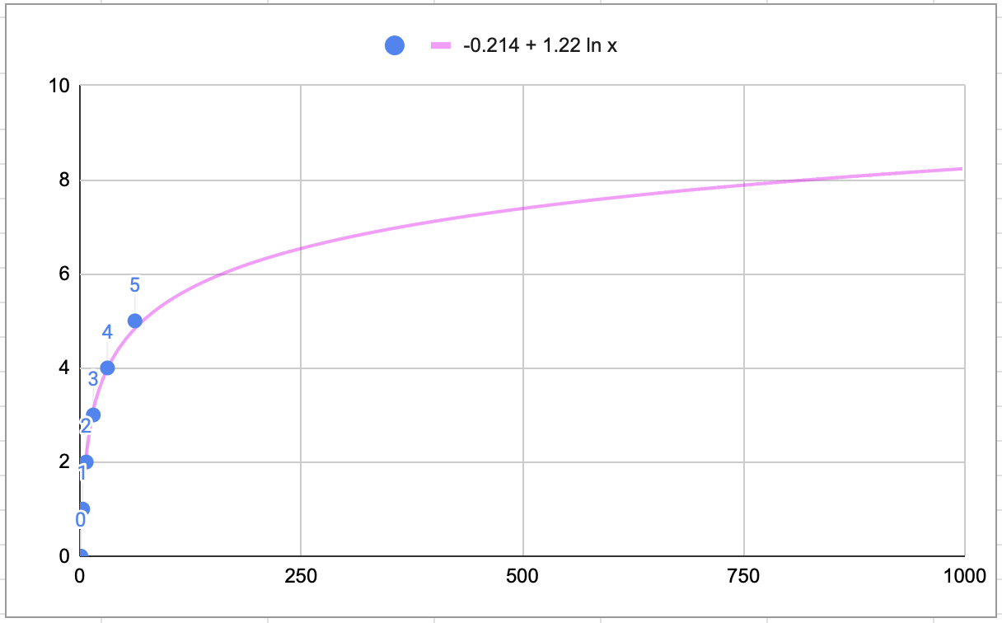
tree height
num nodes

Slide 464
log n

Slide 465
a balanced binary tree has O(log n) height note: the example we just did showed this for a "perfectly balanced" binary tree, but it is also true for just plain ol' balanced binary search trees

Slide 466
implications: searching a binary search tree is O(log n)

Slide 467
what does log look like?

Slide 468
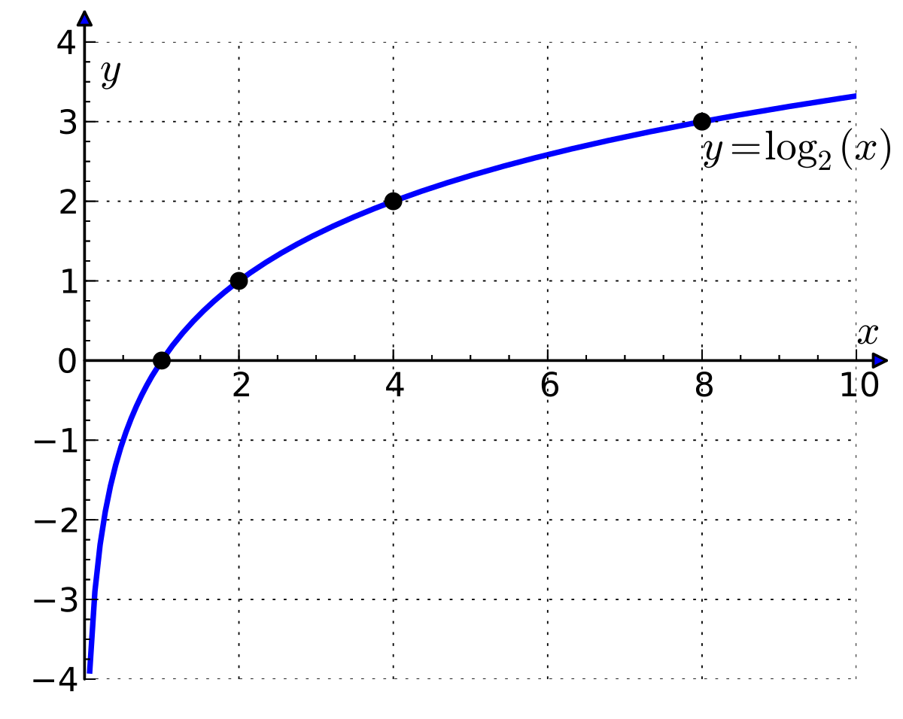

Slide 469
log is the inverse of exponential growth

Slide 470
y = 2^{x}
🧠 solve for x.

Slide 471
y = 2^{x} x = log₂ y

Slide 472
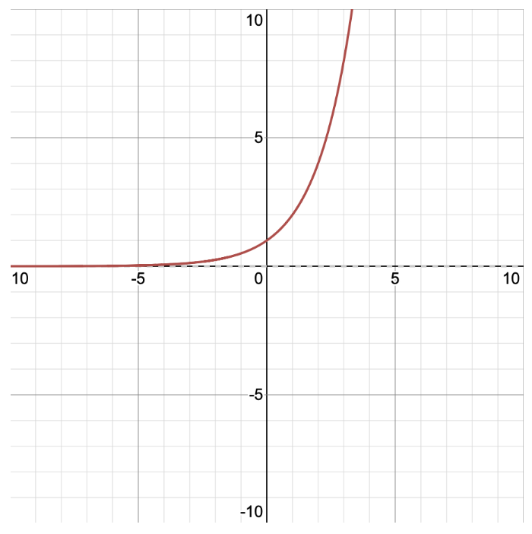
y = 2^{x} x = log₂ y
y
x

Slide 473
y = 2^{x} x = log₂ y
y
x

Slide 474
the change of base formula implies that O(log₂ n) = O(log₁₀ n) = ...

Slide 475
log_{b} n = log_{d} n / log_{d} b

Slide 476
log₂ n = log₁₀ n / log₁₀ 2

Slide 477
log₂ n = log₁₀ n / log₁₀ 2
this is a constant.

Slide 478
log₂ n = c log₁₀ n

Slide 479
O(log₂ n) = O(c log₁₀ n)

Slide 480
O(log₂ n) = O(log₁₀ n)

Slide 481
O(log₂ n) and O(log₁₀ n) are the exact same thing

Slide 482
so you can just say O(log n) and not worry about it 🙂👍

Slide 483
binary search tree details

Slide 484
self-balancing binary search trees

Slide 485
life lesson: it is important that your binary search tree is ✨balanced✨ (otherwise things starts to look a lot like linear search on a linked list ☹️)

Slide 486


Slide 487
self-balancing binary search trees are very cool but painful to implement

Slide 488
heap details

Slide 489
heap application: priority queue

Slide 490

review: queue
remove();

Slide 491
review: queue
remove();

Slide 492
review: queue
add();

Slide 493
review: queue
add();

Slide 494
review: queue
remove();

Slide 495
review: queue

Slide 496
extension: priority queue

Slide 497

extension: priority queue

Slide 498

extension: priority queue
priority 1

Slide 499

extension: priority queue
priority 1
priority 1

Slide 500

extension: priority queue
priority 9
priority 1
priority 1

Slide 501

extension: priority queue
priority 9
priority 1
priority 1
priority 5

Slide 502

extension: priority queue
priority 999
priority 9
priority 1
priority 1
priority 5

Slide 503
extension: priority queue
priority 999
priority 9
priority 1
priority 1
priority 5

Slide 504
a heap's remove() function removes the node with maximum value

Slide 505
a priority queue's remove() function removes the element with highest priority

Slide 506
TODO: club penguin meme

Slide 507
heap application: (implicit) heapsort

Slide 508
because a heap is an always-complete binary tree, we can store a heap "implicitly" as an array using a breadth-first (level-order) traversal!
[ 9 8 7 6 4 1 2 3 5 ]
9
8
7
6
4
1
2
3
5

Slide 509
this lets us do in-place heapsort! (using only swaps)

Slide 510
1. build a heap by calling add(...) over and over 2. deconstruct the heap by calling remove() over and over

Slide 511
[ 7 3 2 4 6 1 8 5 9 ]

Slide 512
[ 7 3 2 4 6 1 8 5 9 ]
7

Slide 513
[ 7 3 2 4 6 1 8 5 9 ]
7
3

Slide 514
[ 7 3 2 4 6 1 8 5 9 ]
7
3
2

Slide 515
[ 7 3 2 4 6 1 8 5 9 ]
7
3
2
🐡
4

Slide 516
[ 7 4 2 3 6 1 8 5 9 ]
7
💦
4
2
3

Slide 517
[ 7 4 2 3 6 1 8 5 9 ]
7
4
2
3

Slide 518
[ 7 4 2 3 6 1 8 5 9 ]
7
4
2
🐡
3
6

Slide 519
[ 7 6 2 3 4 1 8 5 9 ]
7
6
💦
2
3
4

Slide 520
[ 7 6 2 3 4 1 8 5 9 ]
7
6
2
3
4

Slide 521
[ 7 6 2 3 4 1 8 5 9 ]
7
6
2
3
4
1

Slide 522
[ 7 6 2 3 4 1 8 5 9 ]
7
6
2
🐡
3
4
1
8

Slide 523
[ 7 6 8 3 4 1 2 5 9 ]
7
🐡
6
8
3
4
1
2

Slide 524
[ 8 6 7 3 4 1 2 5 9 ]
8
💦
6
7
3
4
1
2

Slide 525
[ 8 6 7 3 4 1 2 5 9 ]
8
6
7
3
4
1
2

Slide 526
[ 8 6 7 3 4 1 2 5 9 ]
8
6
7
3
4
1
2
🐡
5

Slide 527
[ 8 6 7 5 4 1 2 3 9 ]
8
6
7
💦
5
4
1
2
3

Slide 528
[ 8 6 7 5 4 1 2 3 9 ]
8
6
7
5
4
1
2
3

Slide 529
[ 8 6 7 5 4 1 2 3 9 ]
8
6
7
5
4
1
2
🐡
3
9

Slide 530
[ 8 6 7 9 4 1 2 3 5 ]
8
6
7
🐡
9
4
1
2
3
5

Slide 531
[ 8 9 7 6 4 1 2 3 5 ]
8
🐡
9
7
6
4
1
2
3
5

Slide 532
[ 9 8 7 6 4 1 2 3 5 ]
💦
9
8
7
6
4
1
2
3
5

Slide 533
[ 9 8 7 6 4 1 2 3 5 ]
9
8
7
6
4
1
2
3
5

Slide 534
[ 9 8 7 6 4 1 2 3 5 ]
9
8
7
6
4
1
2
3
5

Slide 535
[ 5 8 7 6 4 1 2 3 9 ]
⚓️
5
8
7
6
4
1
2
3

Slide 536
[ 8 5 7 6 4 1 2 3 9 ]
8
⚓️
5
7
6
4
1
2
3

Slide 537
[ 8 6 7 5 4 1 2 3 9 ]
8
6
7
💦
5
4
1
2
3

Slide 538
[ 8 6 7 5 4 1 2 3 9 ]
8
6
7
5
4
1
2
3

Slide 539
[ 8 6 7 5 4 1 2 3 9 ]
8
6
7
5
4
1
2
3

Slide 540
[ 3 6 7 5 4 1 2 8 9 ]
3
⚓️
6
7
5
4
1
2

Slide 541
[ 7 6 3 5 4 1 2 8 9 ]
7
💦
6
3
5
4
1
2

Slide 542
[ 7 6 3 5 4 1 2 8 9 ]
7
6
3
5
4
1
2

Slide 543
[ 7 6 3 5 4 1 2 8 9 ]
7
6
3
5
4
1
2

Slide 544
[ 2 6 3 5 4 1 7 8 9 ]
⚓️
2
6
3
5
4
1

Slide 545
[ 6 2 3 5 4 1 7 8 9 ]
6
⚓️
2
3
5
4
1

Slide 546
[ 6 5 3 2 4 1 7 8 9 ]
6
5
3
💦
2
4
1

Slide 547
[ 6 5 3 2 4 1 7 8 9 ]
6
5
3
2
4
1

Slide 548
[ 6 5 3 2 4 1 7 8 9 ]
6
5
3
2
4
1

Slide 549
[ 1 5 3 2 4 6 7 8 9 ]
⚓️
1
5
3
2
4

Slide 550
[ 5 1 3 2 4 6 7 8 9 ]
5
1
⚓️
3
2
4

Slide 551
[ 5 4 3 2 1 6 7 8 9 ]
5
4
3
💦
2
1

Slide 552
[ 5 4 3 2 1 6 7 8 9 ]
5
4
3
2
1

Slide 553
[ 5 4 3 2 1 6 7 8 9 ]
5
4
3
2
1

Slide 554
[ 1 4 3 2 5 6 7 8 9 ]
⚓️
1
4
3
2

Slide 555
[ 4 1 3 2 5 6 7 8 9 ]
4
⚓️
1
3
2

Slide 556
[ 4 2 3 1 5 6 7 8 9 ]
4
2
3
💦
1

Slide 557
[ 4 2 3 1 5 6 7 8 9 ]
4
2
3
1

Slide 558
[ 4 2 3 1 5 6 7 8 9 ]
4
2
3
1

Slide 559
[ 1 2 3 4 5 6 7 8 9 ]
1
⚓️
2
3

Slide 560
[ 3 2 1 4 5 6 7 8 9 ]
3
💦
2
1

Slide 561
[ 3 2 1 4 5 6 7 8 9 ]
3
2
1

Slide 562
[ 3 2 1 4 5 6 7 8 9 ]
3
2
1

Slide 563
[ 1 2 3 4 5 6 7 8 9 ]
⚓️
1
2

Slide 564
[ 2 1 3 4 5 6 7 8 9 ]
2
💦
1

Slide 565
[ 2 1 3 4 5 6 7 8 9 ]
2
1

Slide 566
[ 2 1 3 4 5 6 7 8 9 ]
2
1

Slide 567
[ 1 2 3 4 5 6 7 8 9 ]
1

Slide 568
[ 1 2 3 4 5 6 7 8 9 ]
1

Slide 569
[ 1 2 3 4 5 6 7 8 9 ]
1

Slide 570
[ 1 2 3 4 5 6 7 8 9 ]

Slide 571
gamedev update (switch to other laptop)

Slide 572
avl tree red black tree anchor n vs. log n priority queue (club analogy) log(n) time implicit heap robots/games

Slide 573
space complexity

Slide 574
john's robots tree algorithm

Slide 575
ANNOUNCEMENTS
today is the Last Lecture Before Thanksgiving Monday!
WARMUP do you have Thanksgiving plans?
do you have a favorite Thanksgiving food?
what does this graph represent?
TODAY
graphs

Slide 576
Boston
Bennington
Concord
Williamstown

Slide 577
record LEC-02

Slide 578
graphs

Slide 579
graph

Slide 580
a directed graph is a super general linked list
a node in a graph has references to any number of other nodes
nodes (vertices) are drawn as circles
references (edges) are drawn as arrows

Slide 581
an undirected graph has line segments instead of arrows

Slide 582
is it a graph?

Slide 583
time for everyone's favorite home game...

Slide 584
is it a tree?
graph
yes
yes
tree rules
one node with zero parents
no node with more than one parent
no cycles
is connected
yes
yes
yes
yes
yes

Slide 585
yes

Slide 586
examples

Slide 587
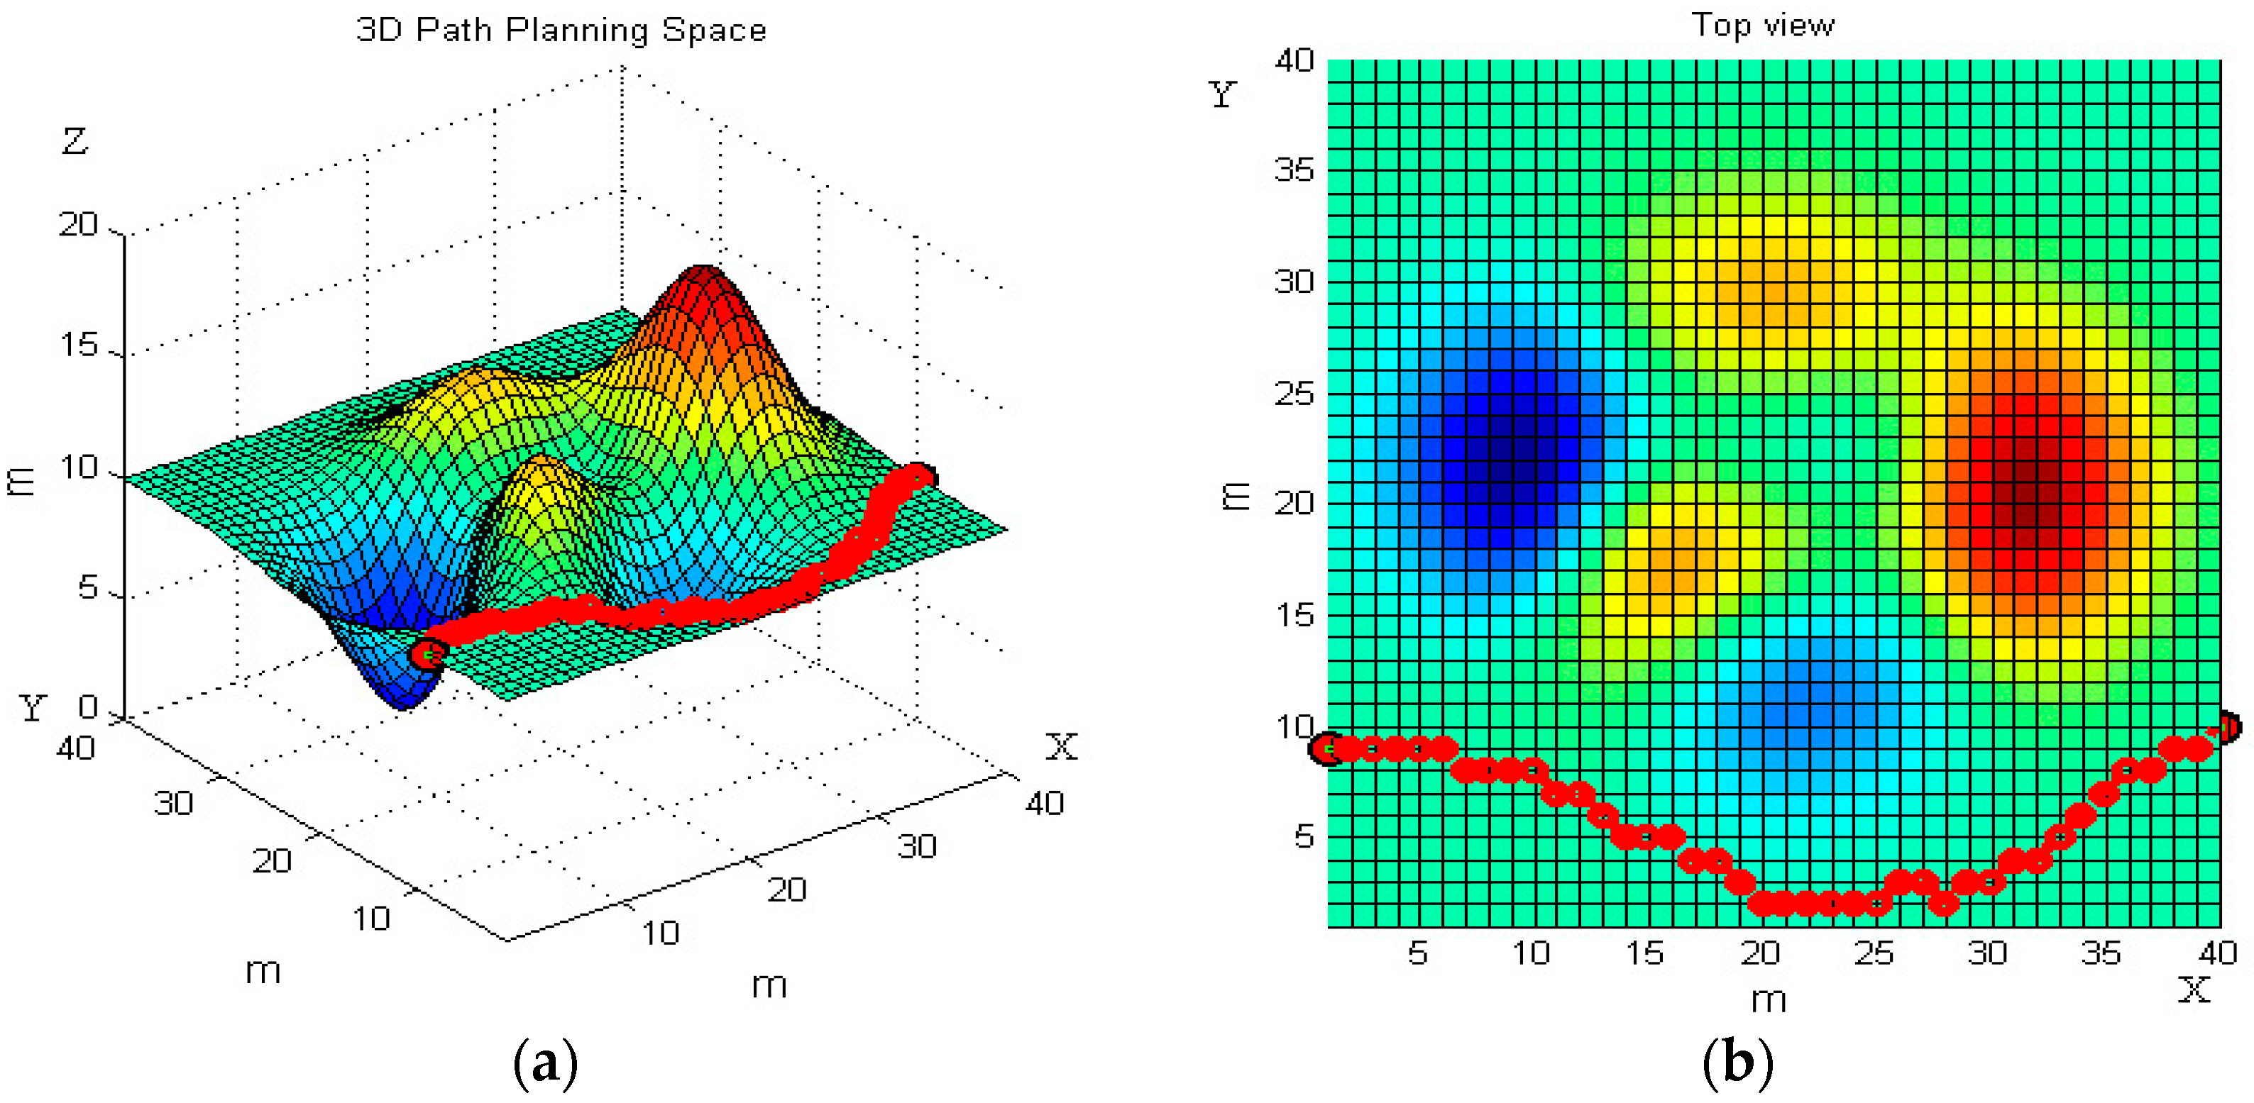

path planning

Slide 588
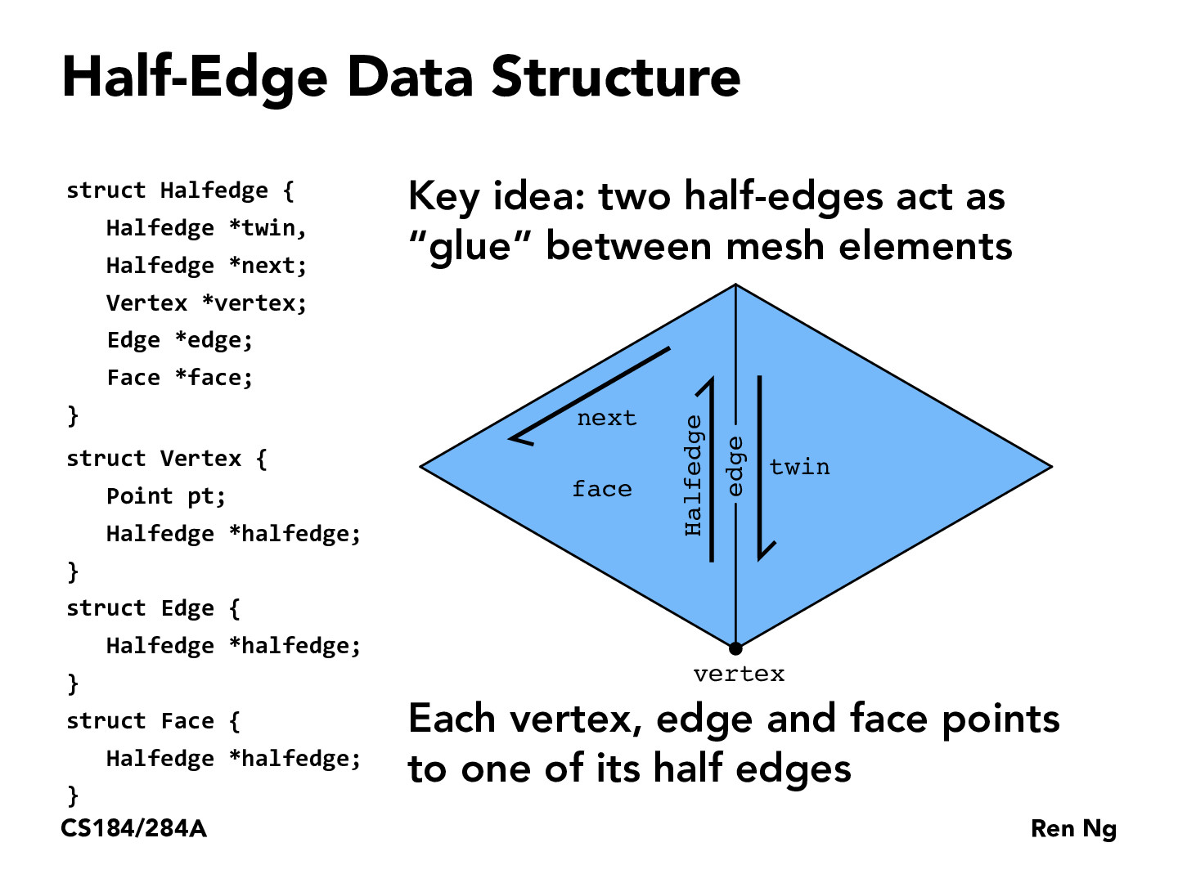
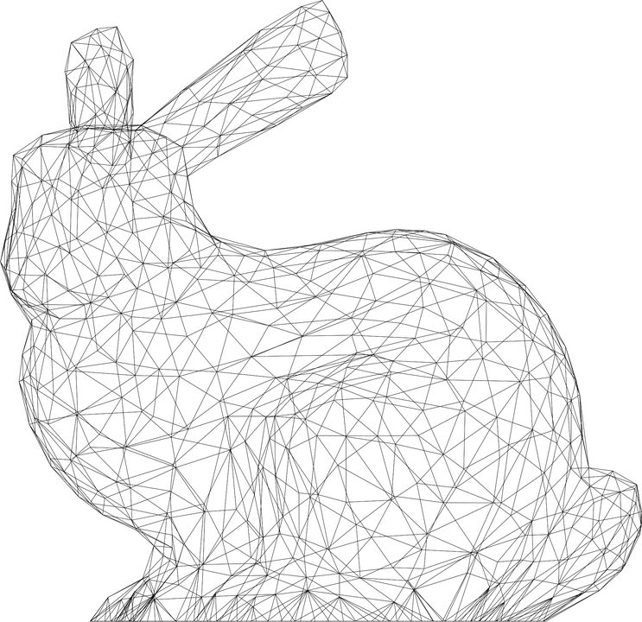

Slide 589
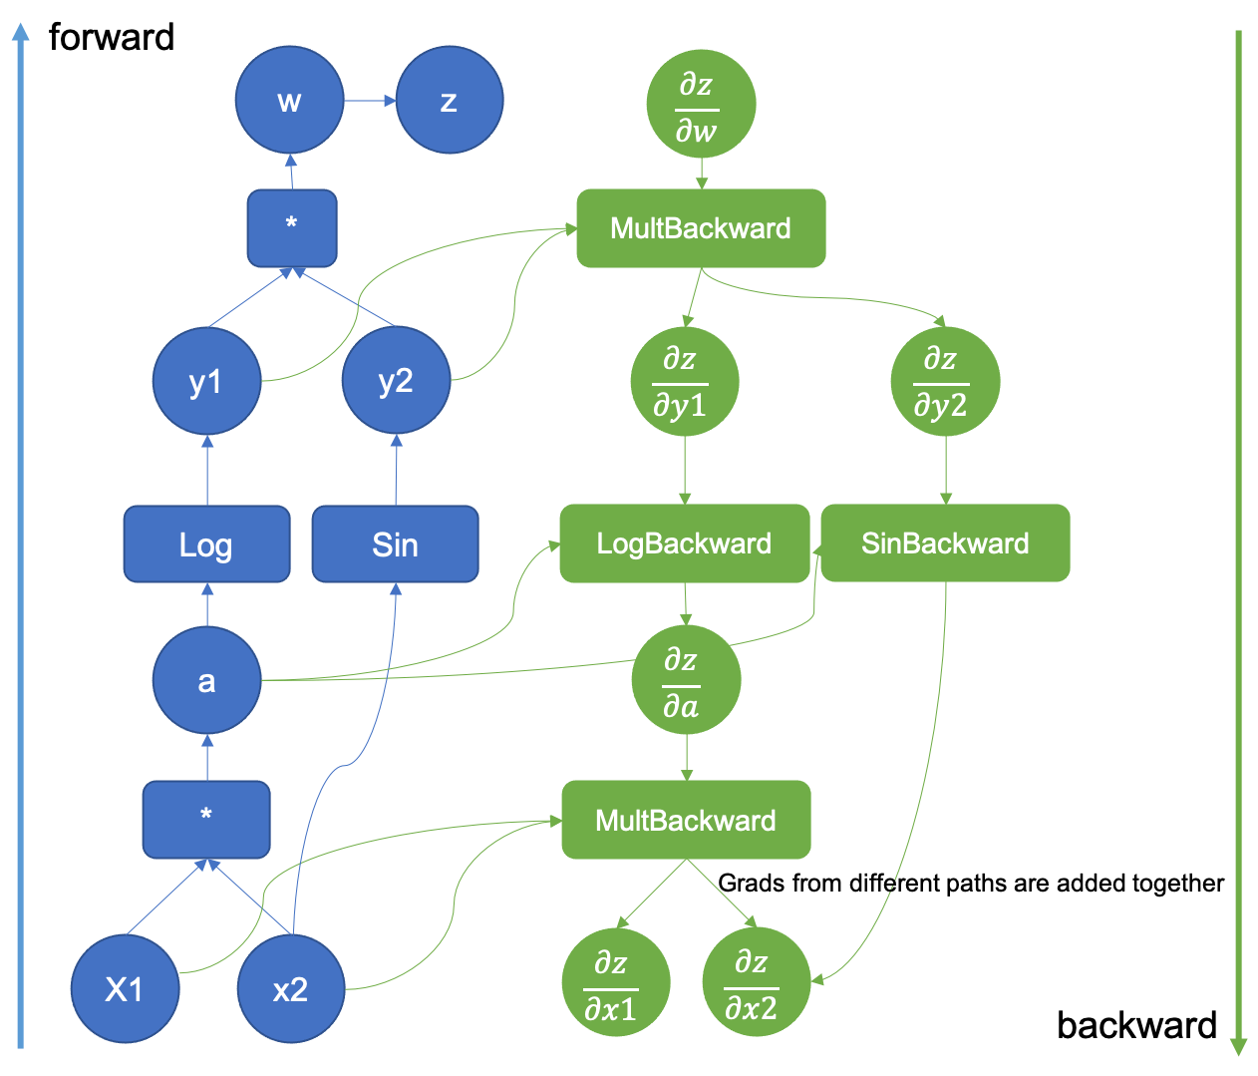

computational
graph
(to take derivatives of deep nets)

Slide 590
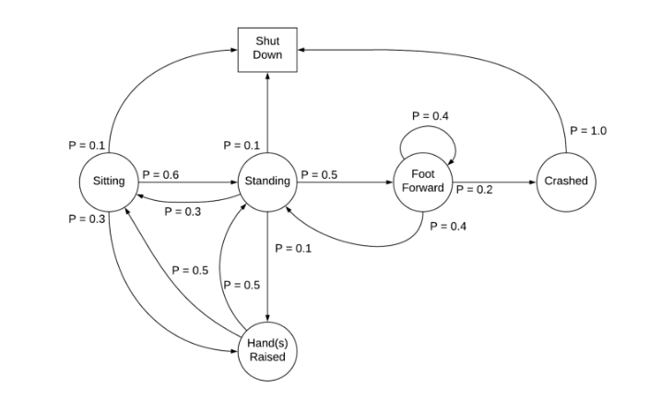
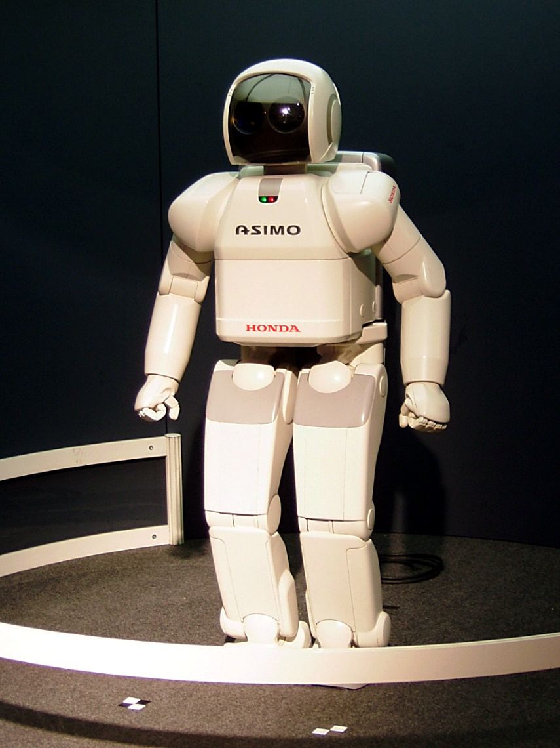
Markov Decision Process

Slide 591
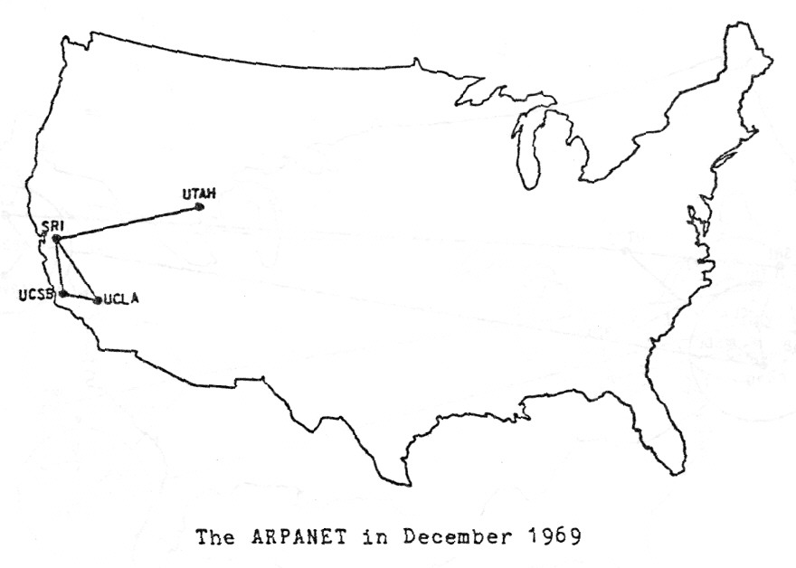

Slide 592

Present day, from Opte The Internet: 1997 - 2021. VIDEO: BARRETT LYON/THE OPTE PROJECT

Slide 593
unlabled directed graph representations

Slide 594
0
1
3
2

Slide 595
Object-Oriented list of nodes
class Graph {
ArrayList<Node> nodes;
Graph() { ... }
}
class Node {
ArrayList<Node> neighbors;
Node() { ... }
}
Graph graph = new Graph();
graph.nodes.add(new Node());
graph.nodes.add(new Node());
graph.nodes.add(new Node());
graph.nodes.add(new Node());
graph.nodes.get(1).neighbors.add(graph.nodes.get(0));
graph.nodes.get(1).neighbors.add(graph.nodes.get(3));
graph.nodes.get(3).neighbors.add(graph.nodes.get(0));
graph.nodes.get(2).neighbors.add(graph.nodes.get(3));
0
1
3
2

Slide 596
Object-Oriented list of nodes
class Graph {
ArrayList<Node> nodes;
Graph() { ... }
}
class Node {
ArrayList<Node> neighbors;
Node() { ... }
}
Graph graph = new Graph();
graph.addNode();
graph.addNode();
graph.addNode();
graph.addNode();
graph.addEdge(1, 0);
graph.addEdge(1, 3);
graph.addEdge(3, 0);
graph.addEdge(2, 3);
0
1
3
2

Slide 597
list of lists
ArrayList<ArrayList<Integer>> graph = new ArrayList<>();
graph.add(new ArrayList<>());
graph.add(new ArrayList<>());
graph.add(new ArrayList<>());
graph.add(new ArrayList<>());
graph.get(1).add(0);
graph.get(1).add(3);
graph.get(3).add(0);
graph.get(2).add(3);
0
1
3
2

Slide 598
list of edges
class Edge {
int i;
int j;
Edge(int i, int j) { ... }
}
int numNodes = 4;
ArrayList<Edge> graph = new ArrayList<>();
graph.add(new Edge(1, 0));
graph.add(new Edge(1, 3));
graph.add(new Edge(3, 0));
graph.add(new Edge(2, 3));
0
1
3
2

Slide 599

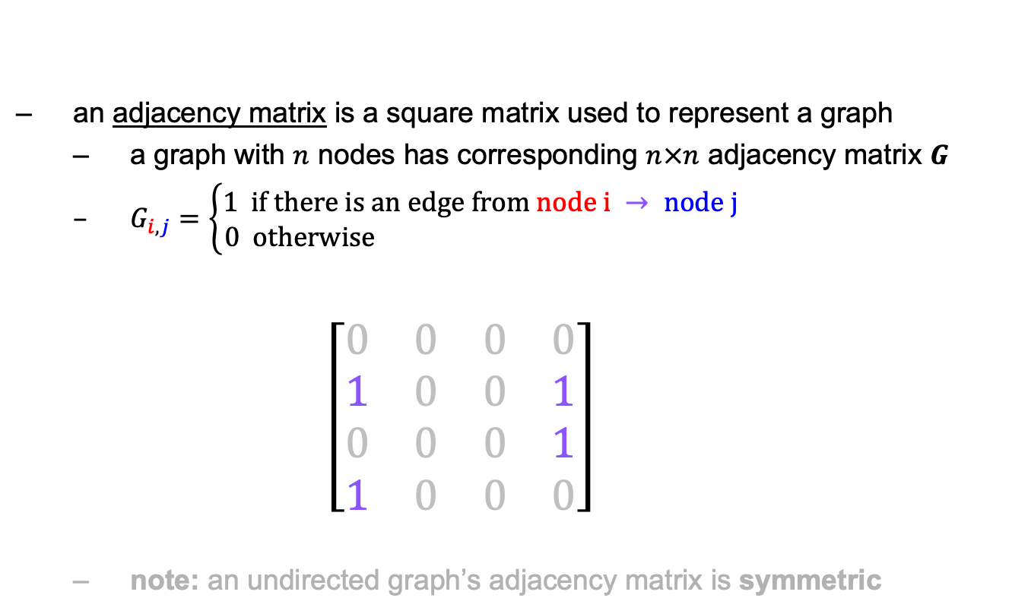

math: adjacency matrix
an adjacency matrix is a square matrix used to represent a graph
a graph with $n$ nodes has corresponding $n×n$ adjacency matrix $G$
$G_{i,j}=\left\{\begin{aligned}1 if there is an edge from node i → node j \\ 0 otherwise \end{aligned}\right.$ $\left[\begin{matrix}0 & 0 & 0 & 0 \\ 1 & 0 & 0 & 1 \\ 0 & 0 & 0 & 1 \\ 1 & 0 & 0 & 0\end{matrix}\right]$
note: an undirected graph’s adjacency matrix is symmetric
$$\begin{matrix}0 & 1 & 2 & 3\end{matrix}$$
0
1
$$\begin{matrix}0 \\ 1 \\ 2 \\ 3\end{matrix}$$
3
2

Slide 600

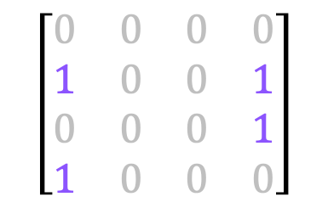

2D array
int[][] graph = new int[4][4];
graph[1][0] = 1;
graph[3][0] = 1;
graph[1][3] = 1;
graph[2][3] = 1;
$$\begin{matrix}0 & 1 & 2 & 3\end{matrix}$$
0
1
$$\begin{matrix}0 \\ 1 \\ 2 \\ 3\end{matrix}$$
$$\left[\begin{matrix}0 & 0 & 0 & 0 \\ 1 & 0 & 0 & 1 \\ 0 & 0 & 0 & 1 \\ 1 & 0 & 0 & 0\end{matrix}\right]$$
3
2

Slide 601
array
int[] graph = new int[4 * 4];
graph[4 * 1 + 0] = 1;
graph[4 * 3 + 0] = 1;
graph[4 * 1 + 3] = 1;
graph[4 * 2 + 3] = 1;
$$\begin{matrix}0 & 1 & 2 & 3\end{matrix}$$
0
1
$$\begin{matrix}0 \\ 1 \\ 2 \\ 3\end{matrix}$$
$$\left[\begin{matrix}0 & 0 & 0 & 0 \\ 1 & 0 & 0 & 1 \\ 0 & 0 & 0 & 1 \\ 1 & 0 & 0 & 0\end{matrix}\right]$$
3
2
$$\left[\begin{matrix}0 & 0 & 0 & 0 & 1 & 0 & 0 & 1 & 0 & 0 & 0 & 1 & 1 & 0 & 0 & 0\end{matrix}\right]$$
$$\begin{matrix}(0, 0) & (0, 1) & (0, 2) & (0, 3) & (1, 0) & (1, 1) & (1, 2) & (1, 3) & (2, 0) & (2, 1) & (2, 2) & (2, 3) & (3, 0) & (3, 1) & (3, 2) & (3, 3)\end{matrix}$$

Slide 602
spaghetti sort

Slide 603
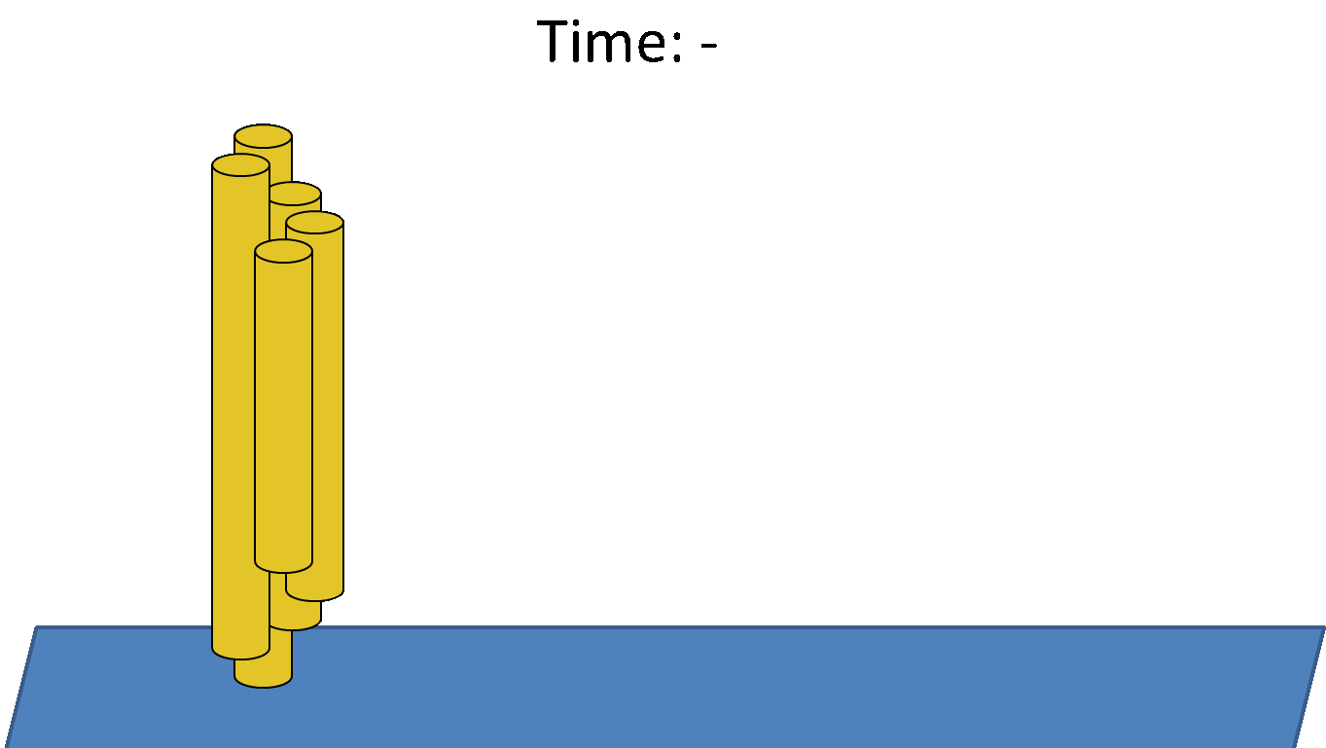

Slide 604
spaghetti sort
given an int[] numbers = new int[n];
for (int i = 0; i < n; ++i)
prepare a piece of spaghetti as long as numbers[i]
loosely grasp the spaghetti and lower it onto a table
for (int i = 0; i < n; ++i)
lower your other hand onto the spaghetti...
...when you feel you have hit the longest spaghetto...
...remove it and set it to the side, in order

Slide 605
🧠 what is the big O of spaghetti sort?

Slide 606
at least O(n * L) where L is the length of the longest spaghetto

Slide 607
🍝 what?

Slide 608
hint: how do you *know* that your hand has hit the spaghetto?

Slide 609
gamedev update

Slide 610
ANNOUNCEMENTS
Today is Welcome Back From Thanksgiving Break Monday
HW-12 comes out tonight (due in 1 week)
HW-13 (Project) comes out tonight (due in 2 weeks)
Practice Final comes out tonight WARMUP
did you have a favorite Thanksgiving food?
if you could make any game you would find fun OR any program you would find useful in the next two weeks, what would it be? TODAY
recursion and dynamic programming

Slide 611
record LEC-02

Slide 612
background: integer overflow

Slide 613
[demo] int a = 1; a *= 10; a *= 10; a *= 10; ...

Slide 614
review: log₂n and 2^{n}

Slide 615
logarithmic growth is the inverse of exponential growth

Slide 616
y = 2^{x}
🧠 solve for x.

Slide 617
y = 2^{x} x = log₂ y

Slide 618
y = 2^{x} x = log₂ y
y
x

Slide 619
y = 2^{x} x = log₂ y
y
x

Slide 620
the Fibonacci sequence

Slide 621
TODO: take photo of board

Slide 622
// F_0 = 0
// F_1 = 1
// F_2 = F_1 + F_0 = 1 + 0 = 1
// F_3 = F_2 + F_1 = 1 + 1 = 2
// F_4 = F_3 + F_2 = 2 + 1 = 3
// F_5 = F_4 + F_3 = 3 + 2 = 5
// ...

Slide 623
recursion

Slide 624
review: recursion basics

Slide 625
recursion
a recursive function is a function that calls itself
each call must make progress towards a base case (when the function finally returns without calling itself)
✨ when in doubt, try something like zero for your base case
class Main {
static int digitSum(int n) {
if (n == 0) {
return 0;
}
return digitSum(n / 10) + (n % 10);
}
public static void main(String[] arguments) {
System.out.println(digitSum(256)); // 13
}
}

Slide 626
static int digitSum(int n) {
if (n == 0) {
return 0;
}
return digitSum(n / 10) + (n % 10);
}
return 0;
return digitSum(0) + 2;
return digitSum(2) + 5;
return digitSum(25) + 6;
int a = digitSum(256);

Slide 627
static int digitSum(int n) {
if (n == 0) {
return 0;
}
return digitSum(n / 10) + (n % 10);
}
return 0;
return digitSum(0) + 2;
return digitSum(2) + 5;
return digitSum(25) + 6;
int a = digitSum(256);

Slide 628
static int digitSum(int n) {
if (n == 0) {
return 0;
}
return digitSum(n / 10) + (n % 10);
}
return 0 + 2;
return digitSum(2) + 5;
return digitSum(25) + 6;
int a = digitSum(256);

Slide 629
static int digitSum(int n) {
if (n == 0) {
return 0;
}
return digitSum(n / 10) + (n % 10);
}
return 2;
return digitSum(2) + 5;
return digitSum(25) + 6;
int a = digitSum(256);

Slide 630
static int digitSum(int n) {
if (n == 0) {
return 0;
}
return digitSum(n / 10) + (n % 10);
}
return 2;
return digitSum(2) + 5;
return digitSum(25) + 6;
int a = digitSum(256);

Slide 631
static int digitSum(int n) {
if (n == 0) {
return 0;
}
return digitSum(n / 10) + (n % 10);
}
return 2 + 5;
return digitSum(25) + 6;
int a = digitSum(256);

Slide 632
static int digitSum(int n) {
if (n == 0) {
return 0;
}
return digitSum(n / 10) + (n % 10);
}
return 7;
return digitSum(25) + 6;
int a = digitSum(256);

Slide 633
static int digitSum(int n) {
if (n == 0) {
return 0;
}
return digitSum(n / 10) + (n % 10);
}
return 7;
return digitSum(25) + 6;
int a = digitSum(256);

Slide 634
static int digitSum(int n) {
if (n == 0) {
return 0;
}
return digitSum(n / 10) + (n % 10);
}
return 7 + 6;
int a = digitSum(256);

Slide 635
static int digitSum(int n) {
if (n == 0) {
return 0;
}
return digitSum(n / 10) + (n % 10);
}
return 13;
int a = digitSum(256);

Slide 636
static int digitSum(int n) {
if (n == 0) {
return 0;
}
return digitSum(n / 10) + (n % 10);
}
return 13;
int a = digitSum(256);

Slide 637
static int digitSum(int n) {
if (n == 0) {
return 0;
}
return digitSum(n / 10) + (n % 10);
}
int a = 13;

Slide 638
fin.

Slide 639
⚠️ recursion hazard 1 repeated computation

Slide 640
🐌 example: slow very slow fibonnaci (is it too late to just use a for loop?)
// F_0 = 0
// F_1 = 1
// F_2 = F_1 + F_0 = 1 + 0 = 1
// F_3 = F_2 + F_1 = 1 + 1 = 2
// F_4 = F_3 + F_2 = 2 + 1 = 3
// F_5 = F_4 + F_3 = 3 + 2 = 5
// ...
static int fib(int n) {
if (n == 0) { return 0; }
if (n == 1) { return 1; }
return fib(n - 1) + fib(n - 2);
}

Slide 641
fib(4)

Slide 642
(fib(3) + fib(2))

Slide 643
((fib(2) + fib(1)) + (fib(1) + fib(0)))

Slide 644
(((fib(1) + fib(0)) + fib(1)) + (fib(1) + fib(0)))

Slide 645
(((1 + 0) + 1) + (1 + 0))

Slide 646
((1 + 1) + 1)

Slide 647
(2 + 1)

Slide 648
3

Slide 649
fib(4)

Slide 650
fib(4)
fib(3)
fib(2)

Slide 651
fib(4)
fib(3)
fib(2)
fib(2)
fib(1)

Slide 652
fib(4)
fib(3)
fib(2)
fib(2)
fib(1)
fib(1)
fib(0)

Slide 653
fib(4)
fib(3)
fib(2)
fib(2)
fib(1)
1
0

Slide 654
fib(4)
fib(3)
fib(2)
1
fib(1)

Slide 655
fib(4)
fib(3)
fib(2)
1
1

Slide 656
fib(4)
2
fib(2)

Slide 657
fib(4)
2
fib(2)
fib(1)
fib(0)

Slide 658
fib(4)
2
fib(2)
1
0

Slide 659
fib(4)
2
1

Slide 660
3

Slide 661
🙂

Slide 662
☹️

Slide 663
3

Slide 664
fib(4)

Slide 665
fib(4)
fib(3)
fib(2)
fib(2)
fib(1)
fib(1)
fib(0)
😱 what about this picture does NOT spark joy?
fib(1)
fib(0)

Slide 666
fib(4)
fib(3)
fib(2)
fib(2)
fib(1)
fib(1)
fib(0)
fib(1)
fib(0)

Slide 667
we computed fib(2) from scratch two seperate times 😱 we are repeating computation! (what a waste 😞)

Slide 668
and for bigger n... there is (much) more repetition

Slide 669
F₆
F₄
F₅
F₂
F₃
F₃
F₄
F₀
F₁
F₁
F₂
F₁
F₂
F₂
F₃
F₀
F₁
F₀
F₁
F₀
F₁
F₁
F₂
F₀
F₁

Slide 670
F₆
F₄
F₅
F₂
F₃
F₃
F₄
F₀
F₁
F₁
F₂
F₁
F₂
F₂
F₃
F₀
F₁
F₀
F₁
F₀
F₁
F₁
F₂
F₀
F₁
🧠 who's that
big O runtime?

Slide 671
exponential 🙀

Slide 672
[fib(5), fib(36), fib(77) demo]

Slide 673
⚠️ recursion hazard 2 stack overflow

Slide 674
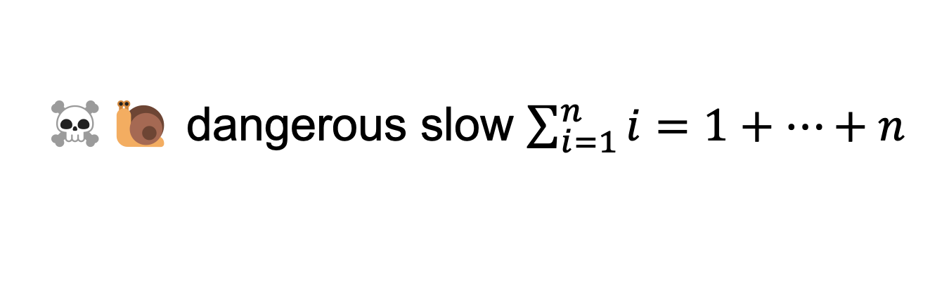
☠️🐌 dangerous slow $\sum_{i=1}^{n}{i}=1+…+n$
// 1 + ... + n
static int sum(int n) {
if (n == 0) return 0;
return n + sum(n - 1);
}

Slide 675
sum(100000)

Slide 676
sum(99999)
sum(100000)

Slide 677
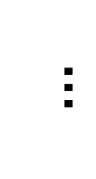
sum(0)
$$…$$
😱 what about this picture does NOT spark joy?
sum(99999)
sum(100000)

Slide 678
the height of the callstack is O(n) 😱 big n → stack overflow! 😞

Slide 679
[sum(100000) demo]

Slide 680
🧠 our depth-first binary (search) tree traversals were recursive... ...should we be worried about them overflowing the callstack?

Slide 681
no. (assuming your tree is ~balanced) callstack height for depth-first balanced binary tree traversal is log(n)
0
1
2
3
4 5
1 1 1 1 1 2 3
0 0 0 0 0 0 0 0 0 0 0
4
5
time

Slide 682
*additionally, some languages/compilers** have "tail-call optimization," which would prevent a stack overflow for sum(100000) **Java is not one of these languages (as our demo showed)

Slide 683
dynamic programming

Slide 684
dynamic programming is when you use the result of previous computation (this is a squishy definition)

Slide 685
F₆
F₄
F₅
F₂
F₃
F₃
F₄
F₀
F₁
F₁
F₂
F₁
F₂
F₂
F₃
F₀
F₁
F₀
F₁
F₀
F₁
F₁
F₂
F₀
F₁

Slide 686
F₆
F₅
F₄
F₄
F₃
F₃
F₂
F₂
F₁
F₁
F₀

Slide 687
F₆
F₅
F₄
F₄
F₃
F₃
F₂
F₂
F₁
F₁
F₀
🧠 who's that
big O runtime?

Slide 688
linear 🙂👍

Slide 689
🙂 linear recursive fibonnaci
static HashMap<Long, Long> table = new HashMap<>();
static long dynamicFib(long n) {
if (n == 0) { return 0; }
if (n == 1) { return 1; }
long Fnm1;
if (table.containsKey(n - 1)) {
Fnm1 = table.get(n - 1);
} else {
Fnm1 = dynamicFib(n - 1);
table.put(n - 1, Fnm1);
}
long Fnm2;
if (table.containsKey(n - 2)) {
Fnm2 = table.get(n - 2);
} else {
Fnm2 = dynamicFib(n - 2);
table.put(n - 2, Fnm2);
}
return Fnm1 + Fnm2;
}

Slide 690
note: there is actually a log(n) algorithm using matrices and "exponentiation by squaring" this algorithm does NOT have floating point problems (all numbers are integers)

Slide 691
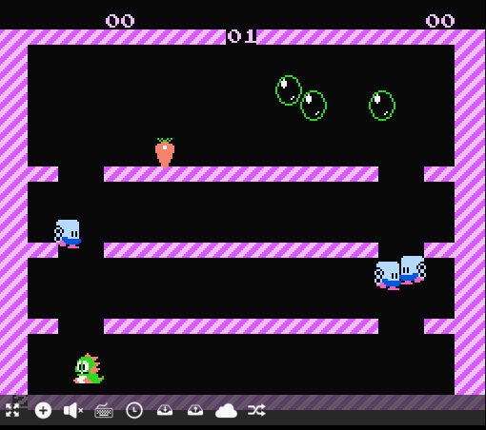
ANNOUNCEMENTS
Today is Wednesday
HW-12 is (due next Monday)
HW-13 (Project) is out (due next next Monday)
Practice Final is out (do it at your leisure) WARMUP
what is (0.1 + 0.1 + 0.1) ?
imagine you wanted to make this thing →
what would you implement 1st? 2nd?
what would you implement LAST? TODAY
who's to say
Bubble Bobble (NES)

Slide 692
record LEC-02

Slide 693
background: floating point error

Slide 694
[demo] double a = 0.0 a += 0.1 a += 0.1 a += 0.1

Slide 695
fibonacci wrapup

Slide 696
recursive O(n) fibonacci

Slide 697
🙂 recursive O(n) fibonnaci
// NOTE: Could also have used an array, with value -1 meaning "not yet computed."
static HashMap<Integer, Long> _table = new HashMap<>();
static F(int k) {
long F_k;
if (_table.containsKey(k)) {
F_k = _table.get(k);
} else {
F_k = fib(k);
_table.put(k, F_k);
}
}
static long fib(int n) {
if (n == 0) { return 0; }
if (n == 1) { return 1; }
return F(n – 1) + F(n – 2);
}

Slide 698
iterative O(n) fibonacci

Slide 699
🙂 iterative O(n) fibonnaci
static long fib(int n) {
long F_i = 1;
long F_im1 = 0;
for (int i = 2; i <= n ++i) {
// (F_i, F_im1) <- (F_i + F_im1, F_i)
long tmp = F_i;
F_i = F_i + F_im1;
F_im1 = tmp;
}
return F_i;
}
(F₁, F₀) ← = (1, 0)
(F₂, F₁) ← (1 + 0, 1) = (1, 1)
(F₃, F₂) ← (1 + 1, 1) = (2, 1)
(F₄, F₃) ← (2 + 1, 2) = (3, 2)
(F₅, F₄) ← (3 + 2, 3) = (5, 3)
def fib(n):
F_i = 1
F_im1 = 0
for i in range(2, n + 1):
F_i, F_im1 = (F_i + F_im1), F_i
return F_im1

Slide 700
closed form fibonacci

Slide 701
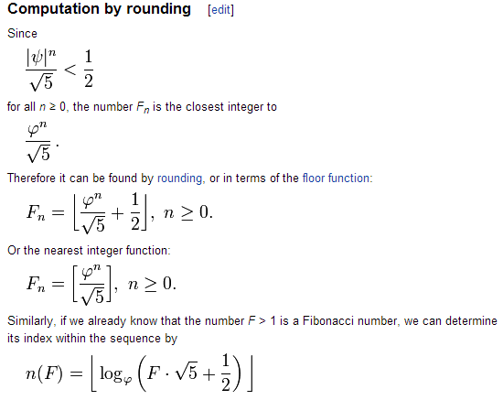

Slide 702
👻 approximate closed-form fibonnaci
// NOTE: Because of floating point error, this does not work for big n.
// (On my computer, returns wrong result for n > 70.)
static long closedFormFib(long n) {
final double goldenRatio = (1.0 + Math.sqrt(5.0)) / 2.0;
return Math.round(Math.pow(goldenRatio, n) / Math.sqrt(5.0));
}

Slide 703
recursion example subset sum

Slide 704
problem overview

Slide 705
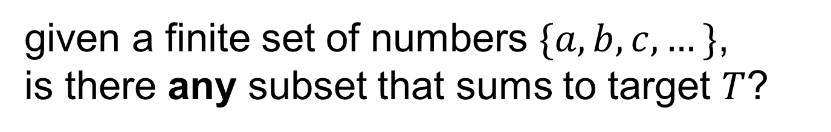
given a finite set of numbers $\{a,b,c,…\}$, is there any subset that sums to target $T$?

Slide 706
no. --Mark

Slide 707
examples
is there any subset of { 1, 3, 5 } that sums to 4?
yes; { 1, 3 }
is there any subset of { 1, 3, 5 } that sums to 9?
yes; { 1, 3, 5 }
is there any subset of { 1, 3, 5 } that sums to 0?
yes; {}
is there any subset of { 1, 3, 5 } that sums to 7?
no

Slide 708
solution method

Slide 709
given a finite set of numbers $\{a,b,c,…\}$, is there any subset that sums to target $T$?

Slide 710

given a finite set of numbers $\{a,b,c,…\}$, is there any subset that sums to target $T$?

Slide 711
any
for each subset...
if it sums to target, return true; 🙂
return false;

Slide 712
🧠 why is this maybe not so easy? "hard" means "hard for a computer to solve quickly"

Slide 713
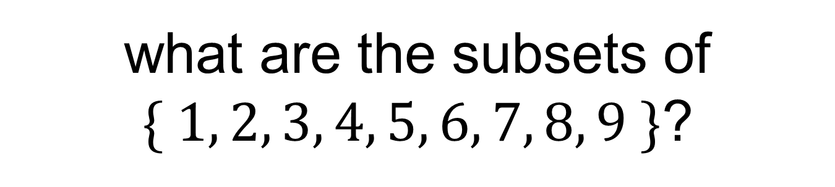
what are the subsets of $\{ 1, 2, 3, 4, 5, 6, 7, 8, 9 \}$?

Slide 714
∅ | {1} | {2} | {3} | {4} | {5} | {6} | {7} | {8} | {9} | {1, 2} | {1, 3} | {1, 4} | {1, 5} | {1, 6} | {1, 7} | {1, 8} | {1, 9} | {2, 3} | {2, 4} | {2, 5} | {2, 6} | {2, 7} | {2, 8} | {2, 9} | {3, 4} | {3, 5} | {3, 6} | {3, 7} | {3, 8} | {3, 9} | {4, 5} | {4, 6} | {4, 7} | {4, 8} | {4, 9} | {5, 6} | {5, 7} | {5, 8} | {5, 9} | {6, 7} | {6, 8} | {6, 9} | {7, 8} | {7, 9} | {8, 9} | {1, 2, 3} | {1, 2, 4} | {1, 2, 5} | {1, 2, 6} | {1, 2, 7} | {1, 2, 8} | {1, 2, 9} | {1, 3, 4} | {1, 3, 5} | {1, 3, 6} | {1, 3, 7} | {1, 3, 8} | {1, 3, 9} | {1, 4, 5} | {1, 4, 6} | {1, 4, 7} | {1, 4, 8} | {1, 4, 9} | {1, 5, 6} | {1, 5, 7} | {1, 5, 8} | {1, 5, 9} | {1, 6, 7} | {1, 6, 8} | {1, 6, 9} | {1, 7, 8} | {1, 7, 9} | {1, 8, 9} | {2, 3, 4} | {2, 3, 5} | {2, 3, 6} | {2, 3, 7} | {2, 3, 8} | {2, 3, 9} | {2, 4, 5} | {2, 4, 6} | {2, 4, 7} | {2, 4, 8} | {2, 4, 9} | {2, 5, 6} | {2, 5, 7} | {2, 5, 8} | {2, 5, 9} | {2, 6, 7} | {2, 6, 8} | {2, 6, 9} | {2, 7, 8} | {2, 7, 9} | {2, 8, 9} | {3, 4, 5} | {3, 4, 6} | {3, 4, 7} | {3, 4, 8} | {3, 4, 9} | {3, 5, 6} | {3, 5, 7} | {3, 5, 8} | {3, 5, 9} | {3, 6, 7} | {3, 6, 8} | {3, 6, 9} | {3, 7, 8} | {3, 7, 9} | {3, 8, 9} | {4, 5, 6} | {4, 5, 7} | {4, 5, 8} | {4, 5, 9} | {4, 6, 7} | {4, 6, 8} | {4, 6, 9} | {4, 7, 8} | {4, 7, 9} | {4, 8, 9} | {5, 6, 7} | {5, 6, 8} | {5, 6, 9} | {5, 7, 8} | {5, 7, 9} | {5, 8, 9} | {6, 7, 8} | {6, 7, 9} | {6, 8, 9} | {7, 8, 9} | {1, 2, 3, 4} | {1, 2, 3, 5} | {1, 2, 3, 6} | {1, 2, 3, 7} | {1, 2, 3, 8} | {1, 2, 3, 9} | {1, 2, 4, 5} | {1, 2, 4, 6} | {1, 2, 4, 7} | {1, 2, 4, 8} | {1, 2, 4, 9} | {1, 2, 5, 6} | {1, 2, 5, 7} | {1, 2, 5, 8} | {1, 2, 5, 9} | {1, 2, 6, 7} | {1, 2, 6, 8} | {1, 2, 6, 9} | {1, 2, 7, 8} | {1, 2, 7, 9} | {1, 2, 8, 9} | {1, 3, 4, 5} | {1, 3, 4, 6} | {1, 3, 4, 7} | {1, 3, 4, 8} | {1, 3, 4, 9} | {1, 3, 5, 6} | {1, 3, 5, 7} | {1, 3, 5, 8} | {1, 3, 5, 9} | {1, 3, 6, 7} | {1, 3, 6, 8} | {1, 3, 6, 9} | {1, 3, 7, 8} | {1, 3, 7, 9} | {1, 3, 8, 9} | {1, 4, 5, 6} | {1, 4, 5, 7} | {1, 4, 5, 8} | {1, 4, 5, 9} | {1, 4, 6, 7} | {1, 4, 6, 8} | {1, 4, 6, 9} | {1, 4, 7, 8} | {1, 4, 7, 9} | {1, 4, 8, 9} | {1, 5, 6, 7} | {1, 5, 6, 8} | {1, 5, 6, 9} | {1, 5, 7, 8} | {1, 5, 7, 9} | {1, 5, 8, 9} | {1, 6, 7, 8} | {1, 6, 7, 9} | {1, 6, 8, 9} | {1, 7, 8, 9} | {2, 3, 4, 5} | {2, 3, 4, 6} | {2, 3, 4, 7} | {2, 3, 4, 8} | {2, 3, 4, 9} | {2, 3, 5, 6} | {2, 3, 5, 7} | {2, 3, 5, 8} | {2, 3, 5, 9} | {2, 3, 6, 7} | {2, 3, 6, 8} | {2, 3, 6, 9} | {2, 3, 7, 8} | {2, 3, 7, 9} | {2, 3, 8, 9} | {2, 4, 5, 6} | {2, 4, 5, 7} | {2, 4, 5, 8} | {2, 4, 5, 9} | {2, 4, 6, 7} | {2, 4, 6, 8} | {2, 4, 6, 9} | {2, 4, 7, 8} | {2, 4, 7, 9} | {2, 4, 8, 9} | {2, 5, 6, 7} | {2, 5, 6, 8} | {2, 5, 6, 9} | {2, 5, 7, 8} | {2, 5, 7, 9} | {2, 5, 8, 9} | {2, 6, 7, 8} | {2, 6, 7, 9} | {2, 6, 8, 9} | {2, 7, 8, 9} | {3, 4, 5, 6} | {3, 4, 5, 7} | {3, 4, 5, 8} | {3, 4, 5, 9} | {3, 4, 6, 7} | {3, 4, 6, 8} | {3, 4, 6, 9} | {3, 4, 7, 8} | {3, 4, 7, 9} | {3, 4, 8, 9} | {3, 5, 6, 7} | {3, 5, 6, 8} | {3, 5, 6, 9} | {3, 5, 7, 8} | {3, 5, 7, 9} | {3, 5, 8, 9} | {3, 6, 7, 8} | {3, 6, 7, 9} | {3, 6, 8, 9} | {3, 7, 8, 9} | {4, 5, 6, 7} | {4, 5, 6, 8} | {4, 5, 6, 9} | {4, 5, 7, 8} | {4, 5, 7, 9} | {4, 5, 8, 9} | {4, 6, 7, 8} | {4, 6, 7, 9} | {4, 6, 8, 9} | {4, 7, 8, 9} | {5, 6, 7, 8} | {5, 6, 7, 9} | {5, 6, 8, 9} | {5, 7, 8, 9} | {6, 7, 8, 9} | {1, 2, 3, 4, 5} | {1, 2, 3, 4, 6} | {1, 2, 3, 4, 7} | {1, 2, 3, 4, 8} | {1, 2, 3, 4, 9} | {1, 2, 3, 5, 6} | {1, 2, 3, 5, 7} | {1, 2, 3, 5, 8} | {1, 2, 3, 5, 9} | {1, 2, 3, 6, 7} | {1, 2, 3, 6, 8} | {1, 2, 3, 6, 9} | {1, 2, 3, 7, 8} | {1, 2, 3, 7, 9} | {1, 2, 3, 8, 9} | {1, 2, 4, 5, 6} | {1, 2, 4, 5, 7} | {1, 2, 4, 5, 8} | {1, 2, 4, 5, 9} | {1, 2, 4, 6, 7} | {1, 2, 4, 6, 8} | {1, 2, 4, 6, 9} | {1, 2, 4, 7, 8} | {1, 2, 4, 7, 9} | {1, 2, 4, 8, 9} | {1, 2, 5, 6, 7} | {1, 2, 5, 6, 8} | {1, 2, 5, 6, 9} | {1, 2, 5, 7, 8} | {1, 2, 5, 7, 9} | {1, 2, 5, 8, 9} | {1, 2, 6, 7, 8} | {1, 2, 6, 7, 9} | {1, 2, 6, 8, 9} | {1, 2, 7, 8, 9} | {1, 3, 4, 5, 6} | {1, 3, 4, 5, 7} | {1, 3, 4, 5, 8} | {1, 3, 4, 5, 9} | {1, 3, 4, 6, 7} | {1, 3, 4, 6, 8} | {1, 3, 4, 6, 9} | {1, 3, 4, 7, 8} | {1, 3, 4, 7, 9} | {1, 3, 4, 8, 9} | {1, 3, 5, 6, 7} | {1, 3, 5, 6, 8} | {1, 3, 5, 6, 9} | {1, 3, 5, 7, 8} | {1, 3, 5, 7, 9} | {1, 3, 5, 8, 9} | {1, 3, 6, 7, 8} | {1, 3, 6, 7, 9} | {1, 3, 6, 8, 9} | {1, 3, 7, 8, 9} | {1, 4, 5, 6, 7} | {1, 4, 5, 6, 8} | {1, 4, 5, 6, 9} | {1, 4, 5, 7, 8} | {1, 4, 5, 7, 9} | {1, 4, 5, 8, 9} | {1, 4, 6, 7, 8} | {1, 4, 6, 7, 9} | {1, 4, 6, 8, 9} | {1, 4, 7, 8, 9} | {1, 5, 6, 7, 8} | {1, 5, 6, 7, 9} | {1, 5, 6, 8, 9} | {1, 5, 7, 8, 9} | {1, 6, 7, 8, 9} | {2, 3, 4, 5, 6} | {2, 3, 4, 5, 7} | {2, 3, 4, 5, 8} | {2, 3, 4, 5, 9} | {2, 3, 4, 6, 7} | {2, 3, 4, 6, 8} | {2, 3, 4, 6, 9} | {2, 3, 4, 7, 8} | {2, 3, 4, 7, 9} | {2, 3, 4, 8, 9} | {2, 3, 5, 6, 7} | {2, 3, 5, 6, 8} | {2, 3, 5, 6, 9} | {2, 3, 5, 7, 8} | {2, 3, 5, 7, 9} | {2, 3, 5, 8, 9} | {2, 3, 6, 7, 8} | {2, 3, 6, 7, 9} | {2, 3, 6, 8, 9} | {2, 3, 7, 8, 9} | {2, 4, 5, 6, 7} | {2, 4, 5, 6, 8} | {2, 4, 5, 6, 9} | {2, 4, 5, 7, 8} | {2, 4, 5, 7, 9} | {2, 4, 5, 8, 9} | {2, 4, 6, 7, 8} | {2, 4, 6, 7, 9} | {2, 4, 6, 8, 9} | {2, 4, 7, 8, 9} | {2, 5, 6, 7, 8} | {2, 5, 6, 7, 9} | {2, 5, 6, 8, 9} | {2, 5, 7, 8, 9} | {2, 6, 7, 8, 9} | {3, 4, 5, 6, 7} | {3, 4, 5, 6, 8} | {3, 4, 5, 6, 9} | {3, 4, 5, 7, 8} | {3, 4, 5, 7, 9} | {3, 4, 5, 8, 9} | {3, 4, 6, 7, 8} | {3, 4, 6, 7, 9} | {3, 4, 6, 8, 9} | {3, 4, 7, 8, 9} | {3, 5, 6, 7, 8} | {3, 5, 6, 7, 9} | {3, 5, 6, 8, 9} | {3, 5, 7, 8, 9} | {3, 6, 7, 8, 9} | {4, 5, 6, 7, 8} | {4, 5, 6, 7, 9} | {4, 5, 6, 8, 9} | {4, 5, 7, 8, 9} | {4, 6, 7, 8, 9} | {5, 6, 7, 8, 9} | {1, 2, 3, 4, 5, 6} | {1, 2, 3, 4, 5, 7} | {1, 2, 3, 4, 5, 8} | {1, 2, 3, 4, 5, 9} | {1, 2, 3, 4, 6, 7} | {1, 2, 3, 4, 6, 8} | {1, 2, 3, 4, 6, 9} | {1, 2, 3, 4, 7, 8} | {1, 2, 3, 4, 7, 9} | {1, 2, 3, 4, 8, 9} | {1, 2, 3, 5, 6, 7} | {1, 2, 3, 5, 6, 8} | {1, 2, 3, 5, 6, 9} | {1, 2, 3, 5, 7, 8} | {1, 2, 3, 5, 7, 9} | {1, 2, 3, 5, 8, 9} | {1, 2, 3, 6, 7, 8} | {1, 2, 3, 6, 7, 9} | {1, 2, 3, 6, 8, 9} | {1, 2, 3, 7, 8, 9} | {1, 2, 4, 5, 6, 7} | {1, 2, 4, 5, 6, 8} | {1, 2, 4, 5, 6, 9} | {1, 2, 4, 5, 7, 8} | {1, 2, 4, 5, 7, 9} | {1, 2, 4, 5, 8, 9} | {1, 2, 4, 6, 7, 8} | {1, 2, 4, 6, 7, 9} | {1, 2, 4, 6, 8, 9} | {1, 2, 4, 7, 8, 9} | {1, 2, 5, 6, 7, 8} | {1, 2, 5, 6, 7, 9} | {1, 2, 5, 6, 8, 9} | {1, 2, 5, 7, 8, 9} | {1, 2, 6, 7, 8, 9} | {1, 3, 4, 5, 6, 7} | {1, 3, 4, 5, 6, 8} | {1, 3, 4, 5, 6, 9} | {1, 3, 4, 5, 7, 8} | {1, 3, 4, 5, 7, 9} | {1, 3, 4, 5, 8, 9} | {1, 3, 4, 6, 7, 8} | {1, 3, 4, 6, 7, 9} | {1, 3, 4, 6, 8, 9} | {1, 3, 4, 7, 8, 9} | {1, 3, 5, 6, 7, 8} | {1, 3, 5, 6, 7, 9} | {1, 3, 5, 6, 8, 9} | {1, 3, 5, 7, 8, 9} | {1, 3, 6, 7, 8, 9} | {1, 4, 5, 6, 7, 8} | {1, 4, 5, 6, 7, 9} | {1, 4, 5, 6, 8, 9} | {1, 4, 5, 7, 8, 9} | {1, 4, 6, 7, 8, 9} | {1, 5, 6, 7, 8, 9} | {2, 3, 4, 5, 6, 7} | {2, 3, 4, 5, 6, 8} | {2, 3, 4, 5, 6, 9} | {2, 3, 4, 5, 7, 8} | {2, 3, 4, 5, 7, 9} | {2, 3, 4, 5, 8, 9} | {2, 3, 4, 6, 7, 8} | {2, 3, 4, 6, 7, 9} | {2, 3, 4, 6, 8, 9} | {2, 3, 4, 7, 8, 9} | {2, 3, 5, 6, 7, 8} | {2, 3, 5, 6, 7, 9} | {2, 3, 5, 6, 8, 9} | {2, 3, 5, 7, 8, 9} | {2, 3, 6, 7, 8, 9} | {2, 4, 5, 6, 7, 8} | {2, 4, 5, 6, 7, 9} | {2, 4, 5, 6, 8, 9} | {2, 4, 5, 7, 8, 9} | {2, 4, 6, 7, 8, 9} | {2, 5, 6, 7, 8, 9} | {3, 4, 5, 6, 7, 8} | {3, 4, 5, 6, 7, 9} | {3, 4, 5, 6, 8, 9} | {3, 4, 5, 7, 8, 9} | {3, 4, 6, 7, 8, 9} | {3, 5, 6, 7, 8, 9} | {4, 5, 6, 7, 8, 9} | {1, 2, 3, 4, 5, 6, 7} | {1, 2, 3, 4, 5, 6, 8} | {1, 2, 3, 4, 5, 6, 9} | {1, 2, 3, 4, 5, 7, 8} | {1, 2, 3, 4, 5, 7, 9} | {1, 2, 3, 4, 5, 8, 9} | {1, 2, 3, 4, 6, 7, 8} | {1, 2, 3, 4, 6, 7, 9} | {1, 2, 3, 4, 6, 8, 9} | {1, 2, 3, 4, 7, 8, 9} | {1, 2, 3, 5, 6, 7, 8} | {1, 2, 3, 5, 6, 7, 9} | {1, 2, 3, 5, 6, 8, 9} | {1, 2, 3, 5, 7, 8, 9} | {1, 2, 3, 6, 7, 8, 9} | {1, 2, 4, 5, 6, 7, 8} | {1, 2, 4, 5, 6, 7, 9} | {1, 2, 4, 5, 6, 8, 9} | {1, 2, 4, 5, 7, 8, 9} | {1, 2, 4, 6, 7, 8, 9} | {1, 2, 5, 6, 7, 8, 9} | {1, 3, 4, 5, 6, 7, 8} | {1, 3, 4, 5, 6, 7, 9} | {1, 3, 4, 5, 6, 8, 9} | {1, 3, 4, 5, 7, 8, 9} | {1, 3, 4, 6, 7, 8, 9} | {1, 3, 5, 6, 7, 8, 9} | {1, 4, 5, 6, 7, 8, 9} | {2, 3, 4, 5, 6, 7, 8} | {2, 3, 4, 5, 6, 7, 9} | {2, 3, 4, 5, 6, 8, 9} | {2, 3, 4, 5, 7, 8, 9} | {2, 3, 4, 6, 7, 8, 9} | {2, 3, 5, 6, 7, 8, 9} | {2, 4, 5, 6, 7, 8, 9} | {3, 4, 5, 6, 7, 8, 9} | {1, 2, 3, 4, 5, 6, 7, 8} | {1, 2, 3, 4, 5, 6, 7, 9} | {1, 2, 3, 4, 5, 6, 8, 9} | {1, 2, 3, 4, 5, 7, 8, 9} | {1, 2, 3, 4, 6, 7, 8, 9} | {1, 2, 3, 5, 6, 7, 8, 9} | {1, 2, 4, 5, 6, 7, 8, 9} | {1, 3, 4, 5, 6, 7, 8, 9} | {2, 3, 4, 5, 6, 7, 8, 9} | {1, 2, 3, 4, 5, 6, 7, 8, 9}

Slide 715

there are $2^{9}$ of them

Slide 716
🧠 why?

Slide 717
each of the 9 elements is either included or not included (excluded) in the subset 9 include/exclude decisions => 2⁹

Slide 718

enumerate

Slide 719

what are the subsets of $\{3, 4, 5\}$?

Slide 720
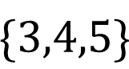

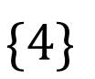













what are the subsets of $\{3, 4, 5\}$?
all possible subsets
include 5?
$$\{\}$$
$$\{5\}$$
$$\{4\}$$
$$\{4,5\}$$
$$\{3\}$$
$$\{3,5\}$$
$$\{3,4\}$$
$$\{3,4,5\}$$
include 4?
$$\{\}$$
$$\{4\}$$
$$\{3\}$$
$$\{3,4\}$$
no
yes
no
yes
include 3?
$$\{\}$$
$$\{3\}$$
no
yes
$$\{\}$$

Slide 721
hint

Slide 722

Question: “can any subset of $\left\{a,b,c,…\right\}$ sum to $T$?” key insight Considering just $a$, we have two cases: 1) exclude $a$ in this case, Equivalent Question: “can any subset of $\{b,c,…\}$ sum to $T$?” 2) include $a$ in this case, Equivalent Question: “can any subset of $\{b,c,…\}$ sum to $T−a$?”

Slide 723


















does any subset of {} sum to 0?
include 2nd
element?
$$\{\}$$
$$\{5\}$$
$$\{4\}$$
$$\{4,5\}$$
$$\{3\}$$
$$\{3,5\}$$
$$\{3,4\}$$
$$\{3,4,5\}$$
$$\{\}$$
$$\{4\}$$
$$\{3\}$$
$$\{3,4\}$$
include 1st
element?
$$\{\}$$
does any subset of $\left\{5\right\}$ sum to 5?
$$\{3\}$$
include 0th
element?
does any subset of $\left\{4,5\right\}$ sum to 5?
$$\{\}$$
does any subset of $\left\{3,4,5\right\}$ sum to 8?

Slide 724
okay cool good luck

Slide 725
Surprise Recursion Tutorial

Slide 726
which one will happen first?
fib(100) finishes
the Sun explodes

Slide 727
final project

Slide 728
final project

Slide 729
You may do your final project on whatever you like, provided you can answer the following questions.
What is the title of my project?
What data structures will I use? Note: Arrays count.
What is the game/app that I am proposing? What does it do? How does it feel?
Will the viewer/player interact with my project? How so?
Does Jim think my project is doable? What is my fallback plan if my project ends up being harder than I expect? What extensions can I do if my project ends up being easier than I expect?
What is the very first thing I will implement? (Drawing "the data" is usually a good first step.)

Slide 730
You may do your final project on whatever you like, provided you can answer the following questions.
What is the title of my project?
What data structures will I use? Note: Arrays count.
What is the game/app that I am proposing? What does it do? How does it feel?
Will the viewer/player interact with my project? How so?
Does Jim think my project is doable? What is my fallback plan if my project ends up being harder than I expect? What extensions can I do if my project ends up being easier than I expect?
What is the very first thing I will implement? (Drawing "the data" is usually a good first step.)

Slide 731
example
Woo!-doku
2D array to represent the board.
A colorful sudoku board, that does a happy dance when you solve it.
Click to select cells. Type numbers on the keyboard to fill in numbers.
Yes! And you can write a sudoku solver or automatic board generation if you have extra time!
Store a board I found on the internet as a 2D array (-1's for empty cells) and draw it to the Terminal using System.out.println.

Slide 732
how are we feeling?

Slide 733
why am i making you make a thing

Slide 734
The only way you’re going to grow is by pushing yourself beyond what you think is possible. --David Goggins

Slide 735
also you were warned 🙂

Slide 736



Slide 737
how not to make a thing

Slide 738
how not to make a thing

Slide 739
note: this advice is like...just advice feel free to ignore (at your own peril) 🙂

Slide 740
project selection

Slide 741


⚠ picking something really, really hard

Slide 742
⚠ picking something with a spooky progress curve
does it work?
deadline
time

Slide 743

⚠ picking something you aren't really interested in (or can't really be extended)
note: though if you love calculators, go for it!

Slide 744
who (doesn't) have a final project idea? discuss amongst each other

Slide 745
focus (just make sudoku)

Slide 746


⚠ solving a more general problem than you need to
don't support arbitrary board sizes!
just make sudoku!
what?!

Slide 747

⚠ writing more general code than you need to
don't support multiple different kinds of puzzles
just make sudoku!

Slide 748

⚠ doing the fun part first
don't make a fun animated menu screen
just make sudoku!

Slide 749

⚠ skipping development steps
consider making a board print to the terminal
before trying to get it working in Cow.java
consider just filling it with nonsense before filling it with a real board
consider hardcoding a starting board by hand
before implementing automatic board generation

Slide 750

then again, sometimes you just gotta go for it.

Slide 751
who (doesn't) know what they're going to implement first? discuss amongst each other

Slide 752
final thoughts

Slide 753
final thoughts
don't be afraid to write code
don't be afraid to delete code
don't be (too) afraid to fail
you will be graded primarily on effort

Slide 754
how are we feeling?

Slide 755
ANNOUNCEMENTS
Today is Fun Cow Friday
WARMUP
how can we tell whether a point is inside a rectangle?
hint: how can we tell whether a number is in between two numbers?
TODAY
grids and parabolic motion in Cow.java Tutorial
(x_{max}, y_{max})
(x, y)
(x_{min}, y_{min})

Slide 756
record LEC-02

Slide 757
(x_{max}, y_{max})
(x, y)
boolean xInside = (x_min < x) && (x < x_max);
boolean yInside = (y_min < y) && (y < y_max);
boolean inside = xInside && yInside;
(x_{min}, y_{min})

Slide 758
(x_{max}, y_{max})
(x, y)
boolean xInside = inBetween(x, x_min, x_max);
boolean yInside = inBetween(y, y_min, y_max);
boolean inside = xInside && yInside;
(x_{min}, y_{min})

Slide 759
(x_{max}, y_{max})
(x, y)
boolean inside = inBetween(x, x_min, x_max)
&& inBetween(y, y_min, y_max);
(x_{min}, y_{min})

Slide 760
let's do it in cow!

Slide 761
clicking on a grid

Slide 762
cat game

Slide 763
parabolic motion

Slide 764
☹️
ANNOUNCEMENTS
Today is the last week of class
Today is Donut Monday (grab a donut!)
Wednesday is Fun Final Review (kahoot? who can say...)
WARMUP
what is object-oriented programming?
are you an object-oriented programmer?
can you jam with the console cowboys in cyberspace?
TODAY
OOP, encapsulation & inheritance

Slide 765
do you know anything about hackers? 🎥

Slide 766
record LEC-02

Slide 767
🍩🍩 P
P

Slide 768
indiana, let it go 🎥

Slide 769

OOP

Slide 770
object (instance of a class)

Slide 771
anatomy of a class (1/2)
class ClassName {
VariableOneType variableOne;
...
FunctionOneReturnType functionOneName(...) { ... }
...
}
a class is (a blueprint for) a lil chunk of data that you can make elsewhere
a class may have any number of variables (fields)
int foo; // objects of this class have an int called foo
a class may have any number of functions (methods)
int bar() { ... } // objects of class have function bar

Slide 772
anatomy of a class (2/2)
class Vector2 {
// instance variables
double x;
double y;
// constructor
Vector2(double x, double y) { ... }
// instance methods
double length() { ... }
...
}

Slide 773
an object is an instance of a class // v is a reference to an instance of the Vector2 class // v is an instance of the Vector2 class // v is a Vector2 object // "v is a Vector2" Vector2 v = new Vector2();

Slide 774
object-oriented programming (OOP) note: jim maybe has opinions (who's to say)

Slide 775
object-oriented programming (OOP)
object-oriented programming means thinking in terms of nouns
"how can i break down this problem into classes/objects?"

Slide 776
object-oriented programming (OOP)
object-oriented programming is NOT just having classes/objects
recall, a class is just (a blueprint for) a lil chunk of data
rather, OOP means my problem-solving is oriented around objects
...instead of, for example, data (data-oriented design)
...functions (functional programming)

Slide 777
object-oriented programming
example: to implement an Object-Oriented PostScript interpreter...
class PSInterpreter
class PSProgram
class PSStack
class PSMap
class PSBuiltinFunction
class PSTwoArgumentBuiltinFunction extends PSBuiltinFunction
class PSAddFunction extends PSTwoArgumentBuiltinFunction
class PSSubFunction extends PSTwoArgumentBuiltinFunction
class PSMulFunction extends PSTwoArgumentBuiltinFunction
class PSDivFunction extends PSTwoArgumentBuiltinFunction
...

Slide 778
unified modeling language (UML) diagram
PSBuiltinFunction
PSTwoArgumentBuiltinFunction
PSAddFunction
PSSubFunction
PSDivFunction
PSMulFunction

Slide 779

real-world example:
SMFL

Slide 780
note that we still haven't written any actual code we've made a plan for how to break the problem into objects

Slide 781
note: it can be hard to break problems into objects
Consider a very basic question: should a Message send itself? ‘Sending’ is a key thing I wish to do with Messages, so surely Message objects should have a ‘send’ method, right? If Messages don’t send themselves, then some other object will have todo the sending, like perhaps some not-yet-created Sender object. Or wait, every sent Message needs a Recipient, so maybe instead Recipient objects should have a ‘receive’ method. This is the conundrum at the heart of object decomposition. Every behavior can be re-contextualized by swapping around the subject, verb, and objects. Senders can send messages to Recipients; Messages can send themselves to Recipients; and Recipients can receive messages. --Brian Will

Slide 782
so

Slide 783
it is very hard to break a problem into objects

Slide 784
but

Slide 785
it is also very popular to break a problem into objects

Slide 786
so let's learn some OOP 🙂👍

Slide 787
inheritance

Slide 788
one class can inherit from another
a child class (derived class, subclass) inherits from its parent class (base class, superclass)
a child inherits (gets, has) its parents' variables and functions
// Inheritance: HW13 is an App
class HW13 extends App {
// HW13 overrides loop()
void loop() {
if (keyPressed('a')) {
...
}
}
}
class App {
Vector2 mousePosition;
boolean keyPressed(...);
void setup() { ... }
void loop() { ... }
...
}

Slide 789
inheritance is convenient, but NOT fundamental (except sometimes in Java)
instead of extending a class, we can store a reference to an instance of it
this is called "composition"
we will have to use the dot operator (a lot) more, but c'est la vie
// Inheritance: HW13 is an App
class HW13 extends App {
// HW13 overrides loop()
void loop() {
if (keyPressed('a')) {
...
}
}
}
// Composition: HW13 has an App
class HW13 {
App app;
void loop() {
if (app.keyPressed('a')) {
...
}
}
}

Slide 790
the fundamental point is that maybe it's nice to reuse code

Slide 791

maybe

Slide 792
final note: inheritance doesn’t simplify a problem so much as i t s p r e a d s i t o u t (and spreads it around?)

Slide 793
encapsulation

Slide 794


Slide 795
encapsulation
encapsulation is the idea that a class should be like a "capsule"
the variables inside the capsule should be private
users of the class CANNOT touch them
for its users, the class should expose safe, public functions

Slide 796
void put(KeyType key, ValueType value) { ... }
ValueType get(KeyType key) { ... }
int size() { return this._size; }
ArrayList<KeyValuePair>[] buckets;
int _size;
encapsulated hashmap

Slide 797
note: this probably makes sense the typical user of a hashmap shouldn't be messing with the private array (and perhaps the exceptional user should write their own hashmap)

Slide 798





big idea: encapsulation can hide away messy, dangerous details
note: this is just a metaphor;
do NOT play with fire

Slide 799
however encapsulation can maybe be taken too far
bullet.age++;
bullet.setAge(bullet.getAge() + 1);
bullet.ageUp(); // ?

Slide 800
OOP considered maybe mildly frictious to prototyping

Slide 801
final note: encapsulation doesn’t add functionality encapsulation removes functionality

Slide 802
spicy take 🌶️

Slide 803
iterators

Slide 804
cool gradient in cow

Slide 805

A N N O U N C E M E N T S
today is Fun Kahoot Wednesday Final Review
friday is the last day of class
also doughnuts
W A R M U P
what is a computer program?
what is programming?
what is a data structure?

Slide 806

🌞
ANNOUNCEMENTS
today is Fun Kahoot Wednesday Final Review
friday is the last day of class
also doughnuts
WARMUP
what is a computer program?
what is programming?
what is a data structure?

Slide 807
record LEC-02

Slide 808
logistics

Slide 809
final exam

Slide 810
what has this course been about?

Slide 811
data structures & big O runtime as i review... use the big O runtimes to remind yourself how the data structures work 🙂👍

Slide 812
data structures

Slide 813
what is the most important data structure?

Slide 814
quadtrees

Slide 815
just kidding

Slide 816
it's arraaaaaaays.

Slide 817
(also trees, but mostly arrays.)

Slide 818
an array is a sequence of contiguous elements
the length of an array is fixed
⏱️ creating an array takes O(n) time, where n is the length of the array
because the elements are all the same size and all right next to each other, accessing an array is FAST
⏱️ getting the value of the i-th element of an array takes O(1) time
⏱️ setting the value of the i-th element of an array takes O(1) time

Slide 819
a string is internally an array of characters
⏱️ adding (concatenating) two strings of length n is an O(n) operation
we have to make a new string of length 2n, which is O(n)

Slide 820
we used an array to implement an array list, which automatically resizes itself
⏱️ when the internal private array is not full, adding is O(1)
⏱️ when the internal private array is full, adding is O(n)
have to make a new array (of, for example, twice the length) and copy

Slide 821
we used an array list to implement a stack and a queue
stacks and queues restrict the way we access a sequence of elements
a stack can push an element to the top & pop the top element
🥞
a queue can add an element to the back & remove the front element
🚶‍♀️🚶‍♂️🚶‍♀️🚶‍♀️🚶‍♂️🚶‍♂️🚶‍♂️

Slide 822
we can use an array of array lists to implement a hash map
⏱️ putting (adding) a key-value pair into a hash map is O(1)
it's a "slow O(1)," which involves hashing the key
in separate chaining (like we did in class), this takes us to a bucket
if the key was already in the bucket, we overwrite its value
otherwise we add the key-value pair to the bucket
⏱️ get key's value from a hash map is O(1)

Slide 823
arrays. (also trees, but mostly arrays.)

Slide 824
a node is a little teeny class
a node can store data (like a value) as well as references to other nodes

Slide 825
a chain of nodes is a linked list
a linked list has the same interface as an array list, but acts very differently
⏱️ adding to the end of a singly linked list is O(n)
⏱️ getting an element by index is O(n) ☹

Slide 826
a branching chain of nodes (with no cycles) is a tree
each node has references to its children
a node's children & its children's children & its children's children's children, ... are called its descendants
the node with no parents is called the root

Slide 827
a tree where each node can only have up to two children is a binary tree
a node in a binary tree can have a left child and a right child
the height of a balanced binary tree is O(log n)

Slide 828
binary search trees and heaps are special kinds of binary trees
in a binary search tree, each node's value is greater than the values of all of its left descendants and less than the values of all of its right descendants
⏱️ searching a balanced binary search tree is O(log n)
in a max binary heap, each node's value is greater than the values of both of its children
⏱️ adding an element to a max binary heap is O(log n)
🐡 add to the first empty slot and swim up
⏱️ removing the max element (root) from a max binary heap is O(log n)
⚓ swap the last element with the root and sink down

Slide 829
what does it all mean?

Slide 830
here's my attempt to summarize the course in a few sentences

Slide 831
136
data means numbers (letters are numbers, colors are numbers, ...)
there's no one perfect way to organize your data
it depends on the problem
to find a good data structure for a particular problem, we can...
...just try an array first; if that works, great, we're done 🙂👍
...compare different data structures using math (big O notation)
...in terms of speed
...in terms of space
...compare different data structure's usage code
...an array might be fast, but is it pleasant?

Slide 832
136 was us moving from finding a solution... ...to finding a good solution

Slide 833
and starting to build the tools and confidence to solve bigger problems

Slide 834
like the final project 😬👍

Slide 835
what does it all mean?

Slide 836
what does it all mean?

Slide 837
what does it all meme?

Slide 838


Slide 839


Slide 840
increment operator
to "increment" means to increase the value of a number by one
i = i + 1;
i += 1;
the pre-increment ++i increments i and returns the new value of i
j = ++i; // i = i + 1;
// j = i;
the post-increment i++ increments i and returns the old value of i
j = i++; // j = i;
// i = i + 1;

Slide 841
decrement operator
to "decrement" means to decrease the value of a number by one
i = i - 1;
i -= 1;
the pre-decrement --i decrements i and returns the new value of i
j = --i; // i = i - 1;
// j = i;
the post-decrement i-- decrements i and returns the old value of i
j = i--; // j = i;
// i = i - 1;

Slide 842
story time ☕️

Slide 843


Slide 844


Slide 845


Slide 846
{
}
goto fail;

Slide 847


Caaaaaaaaaaaarl
e.g., Imagine a classroom with $n$ students. I want to figure out if any students are named Carl.
I need an ✨Algorithm✨ -- boolean isAnyoneNamedCarl(Student[] students);
What is the big O of the following algorithms?
Algorithm 1: Ask each student, one at a time, “Are you named Carl?”
Algorithm 2: Pass a paper around the room, and have each student write their name on it. Then take the paper, and read through it.
Algorithm 3: The students draw straws. The student who draws the short straw must leave. On their way out of the room, ask them whether their name is Carl. Repeat this procedure until the room is empty.
Algorithm 4: Play Kahoot. The winner legally changes their name to Carl.

Slide 848
mental model of an array
elements live in equally-sized boxes all right next to each other
🟩🟩🟩🟩🟩🟩🟩🟩
the array itself lives "in memory"

Slide 849
mental model of an array
elements live in equally-sized boxes all right next to each other
🟩🟩🟩🟩🟩🟩🟩🟩
the array itself lives "in memory"

Slide 850
☠ example: bad very bad broken array copy

Slide 851
☠ example: bad very bad broken array copy
import java.util.*;
class Main {
public static void main(String[] arguments) {
int[] source = { 3, 4, 5 };
int[] destination = source;
source[0] = 7;
System.out.println(Arrays.toString(source));
System.out.println(Arrays.toString(destination));
}
}

Slide 853

not broken
broken
developing one thing at a time

Slide 854
not broken
A is broken
B is broken
A and B are both broken
developing two things at a time

Slide 855

asymptotic bug-finding time

Slide 856

$$𝒪(2^{n})$$
gl;hf 🙂👍

Slide 857

code up the entire program without compiling it
compile early; compile often

Slide 858

compilers

Slide 859

DOCUMENTATION

Slide 860
Tungsten break 😀 did you know the density of Tungsten is 19.25 g/cm³? Gold is 19.32 g/cm³ did you know Tungsten is really hard? Tungsten alloys can be as hard as Sapphire! that's really hard! Tungsten is expensive (that cube is $60) but not like...that expensive what could YOU do with Tungsten?

Slide 861
if (token.type == 2) {
...
}
if (token.type == Token.TYPE_STRING) {
...
}

Slide 862

previously, on Hans the Parrot

Slide 863
🐧🦉
🦜
🐤
🪣
🪣
🐦
🦆🐓🦃
🪣
🪣
🪣
Joe Kahoot Cheep Hans Doug Io Gary Max
0
1
2
3
4
👮

Slide 864
is this Hans?
buckets[bucketIndex].get(i).key.equals("Hans")?
🐧🦉
🦜
🐤
🪣
🪣
🐦
🦆🐓🦃
🪣
🪣
🪣
Joe Kahoot Cheep Hans Doug Io Gary Max
0
1
2
2
3
4
👮
which bucket is Hans in?
Math.floorMod("Hans".hashCode(), buckets.length)
map.get("Hans")

Slide 865
☃️

Slide 866
🐍
3.0
head
|
|
head.next
|
|
|
|
|
null

Slide 867
"the stack"
local variable primitives & references to Objects
undefined by default (will NOT compile if used)
"the heap"
the actual Objects (arrays and String's count as Objects)
cleared to 0 or null by default

Slide 869
LinkedList list;
{
Node node;
String string;
list = new LinkedList();
node = new Node();
string = "Hans";
node.value = string;
list.head = node;
node = new Node();
string = "Parrot";
node.value = string;
list.head.next = node;
}
list
0x11111111
0x22222222
0x88888888 0x33333333
0x99999999 null
H a n s
P a r r o t

Slide 870
can be seen as

Slide 873
jim
careful: these nodes are
the children of the node with value jim
jim's mom
jim's dad
jim's mom's mom
jim's mom's dad
jim's dad's mom
jim's dad's dad

Slide 874
breadth-first vs. (pre-order) depth-first
"a persistent, optimistic, very thorough worm" –Mark Hopkins

Slide 875
quadtree rabbit hole 🐰

Slide 876
2 * 3
+ 4
who's that
traversal order?
+
in-order!
*
4
2
3

Slide 877
[ 7 4 2 3 6 1 8 5 9 ]
7
4
2
3

Slide 878
[ 7 4 2 3 6 1 8 5 9 ]
7
4
2
🐡
3
6

Slide 879
[ 7 6 2 3 4 1 8 5 9 ]
7
6
💦
2
3
4

Slide 880
extension: priority queue
priority 9
priority 1
priority 1
priority 5

Slide 881
extension: priority queue
priority 999
priority 9
priority 1
priority 1
priority 5

Slide 882
y = 2^{x} x = log₂ y
y
x

Slide 883
y = 2^{x} x = log₂ y
y
x

Slide 884
enumerate

Slide 885
🙂👍

Slide 886
🥲👍

Slide 887
homework ✨ how do the post-midterm homeworks work? can you "run them by hand?"

Slide 888


1
int

Slide 889



Slide 890



Slide 891



Slide 892



Slide 893

how do you interpret PostScript?

Slide 894

how do you generate text?

Slide 895

how do you create
& change a linked list?

Slide 896

how do you store a vocabulary in a tree (trie)?

Slide 897


Slide 898

what is the big O runtime of a piece of code?

Slide 899
🦉

Slide 900
🦉 kahoot

Slide 901
🦉 kahoot !

Slide 902
questions

